Slide 1
Jolly Grammar
5a-12

Slide 2
Spelling Test 6

Slide 3
agency

Slide 4
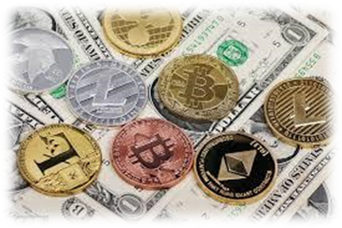
agency
currency

Slide 5
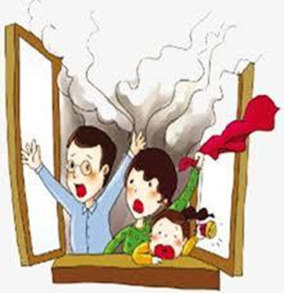
agency
currency
emergency

Slide 6
agency
currency
emergency
potency

Slide 7
agency
currency
emergency
potency
tendency

Slide 8
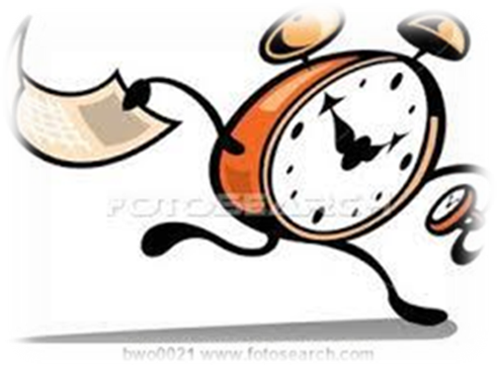
agency
currency
emergency
potency
tendency
urgency

Slide 9
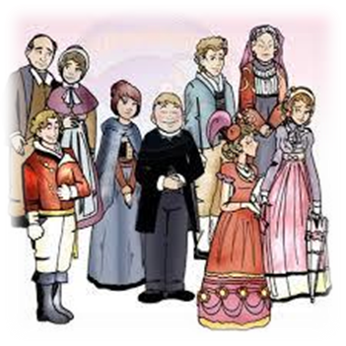
agency
currency
emergency
potency
tendency
urgency
7. regency

Slide 10
agency
currency
emergency
potency
tendency
urgency
7. regency
8. fluency

Slide 11
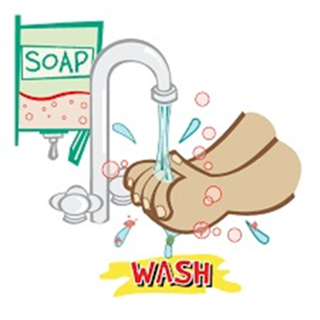
agency
currency
emergency
potency
tendency
urgency
7. regency
8. fluency
9. frequency

Slide 12
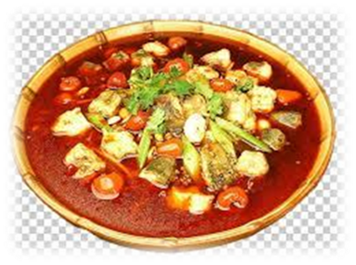
agency
currency
emergency
potency
tendency
urgency
7. regency
8. fluency
9. frequency
10. pungency

Slide 13
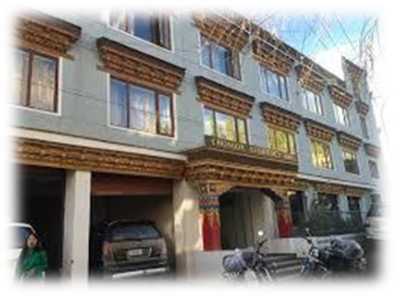
agency
currency
emergency
potency
tendency
urgency
7. regency
8. fluency
9. frequency
10. pungency
11. residency

Slide 14
agency
currency
emergency
potency
tendency
urgency
7. regency
8. fluency
9. frequency
10. pungency
11. residency
12. efficiency

Slide 15
agency
currency
emergency
potency
tendency
urgency
7. regency
8. fluency
9. frequency
10. pungency
11. residency
12. efficiency
13. coherency

Slide 16
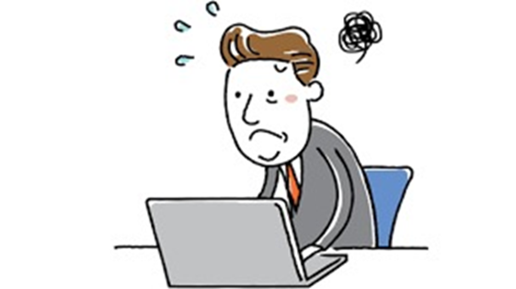
agency
currency
emergency
potency
tendency
urgency
7. regency
8. fluency
9. frequency
10. pungency
11. residency
12. efficiency
13. coherency
14. incompetency

Slide 17
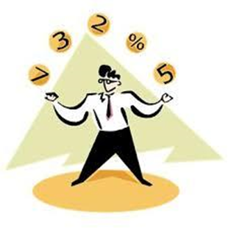
agency
currency
emergency
potency
tendency
urgency
7. regency
8. fluency
9. frequency
10. pungency
11. residency
12. efficiency
13. coherency
14. incompetency
15. proficiency

Slide 18
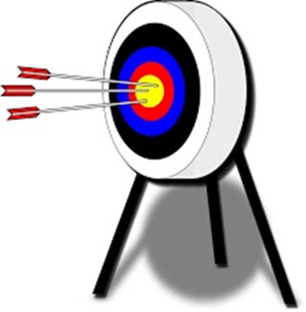
agency
currency
emergency
potency
tendency
urgency
7. regency
8. fluency
9. frequency
10. pungency
11. residency
12. efficiency
13. coherency
14. incompetency
15. proficiency
16. consistency

Slide 19
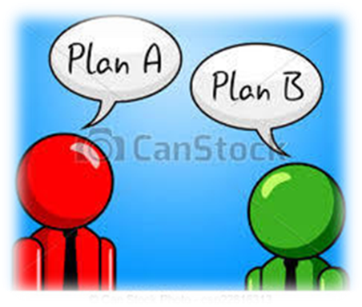
agency
currency
emergency
potency
tendency
urgency
7. regency
8. fluency
9. frequency
10. pungency
11. residency
12. efficiency
13. coherency
14. incompetency
15. proficiency
16. consistency
17. contingency

Slide 20
agency
currency
emergency
potency
tendency
urgency
7. regency
8. fluency
9. frequency
10. pungency
11. residency
12. efficiency
13. coherency
14. incompetency
15. proficiency
16. consistency
17. contingency
18. interdependency

Slide 21
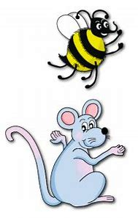
Let’s review
Present Participles.

Slide 22
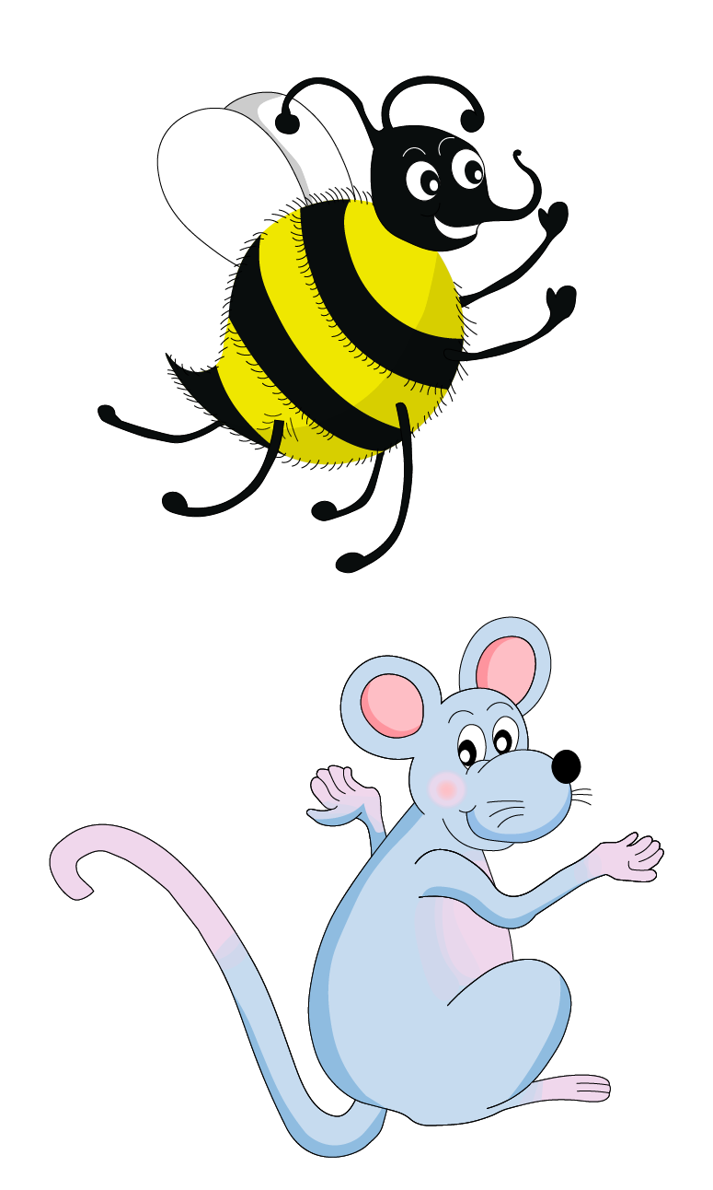
Present participle
～ing
①continuous
②adjective
③gerund

Slide 23
Present participle
①continuous
I am playing tennis.

Slide 24
Present participle
～ing
①continuous
②adjective
③gerund

Slide 25
Present participle
②adjective
a galloping horse
an interesting book

Slide 26
Present participle
～ing
①continuous
②adjective
③gerund

Slide 27
Present participle
③gerund
Dancing is fun.

Slide 28
Present participle
～ing
Past participle
～ed

Slide 29
Past participle
～ed
I baked cake.
a baked cheesecake

Slide 30
Verb | Present Participle | Past Participle
test | testing | tested
wave
lie
clap
try
stay

Slide 31
Verb | Present Participle | Past Participle
test | testing | tested
wave | waving | waved
lie | lying | lied
clap | clapping | clapped
try | trying | tried
stay | staying | stayed

Slide 32
Activity Page:
Present and Past Participles

Slide 33
Verb | Present Participle | Past Participle
to accept | accepting | accepted
to enter | entering | entered
to die | dying | died
to marry | marrying | married
to annoy | annoying | annoyed
to damage | damaging | damaged

Slide 34
Verb | Present Participle | Past Participle
to disturb | disturbing | disturbed
to copy | copying | copied
to chop | chopping | chopped
to permit | permitting | permitted
to compete | competing | competed
to applaud | applauding | applauded

Slide 35
Verb | Present Participle | Past Participle
to spray | spraying | sprayed
to exercise | exercising | exercised
to terrify | terrifying | terrified
to worry | worrying | worried
to unwrap | unwrapping | unwrapped
to disapprove | disapproving | disapproved

Slide 36
Assignment
Copy out the syllables of each spelling word (page 20).

Slide 37
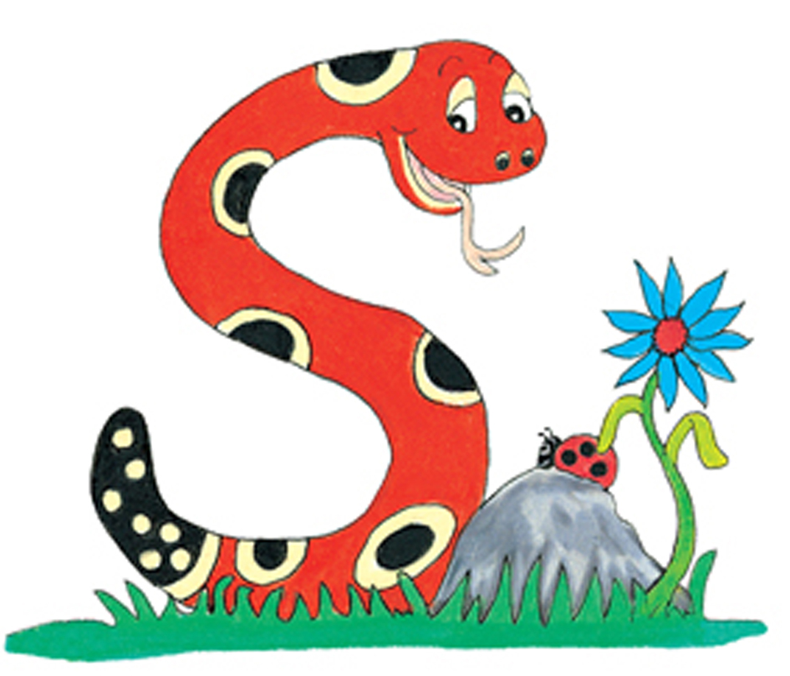
Thank you.
See you
next time!

