Slide 1
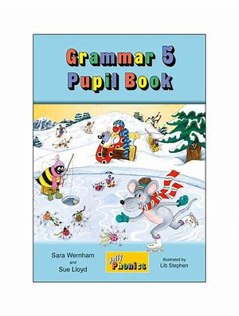
Jolly Grammar
5a-11

Slide 2
Parsing & Sentence Walls

Slide 3
He sang the old song beautifully.

Slide 4
He sang the old song beautifully.

Slide 5
He sang the old song beautifully.
Subject
He
Verb
sang
beautifully
Object
song
the old

Slide 6
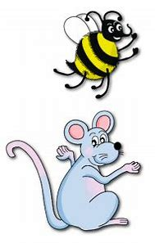
Let’s review
Soft c.

Slide 7
resident

Slide 8
resident ●

Slide 9
resident ●
residency

Slide 10
resident ●
residence

Slide 11
resident ●
residence
residency

Slide 12
resident ●
residence
residency

Slide 13
resident ●
residence
residency
emergence

Slide 14
resident ●
residence
residency
emergence
emergency

Slide 15
Spelling List
<-ency>

Slide 16
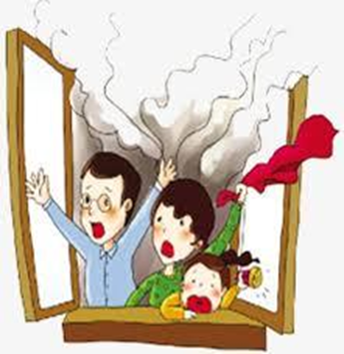
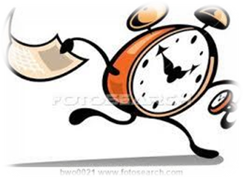
agency currency emergency
potency tendency urgency

Slide 17
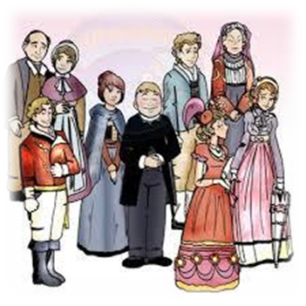
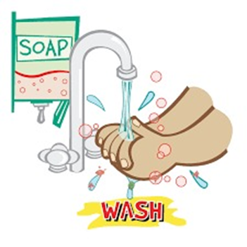
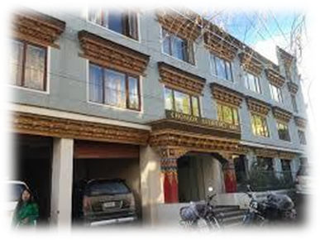
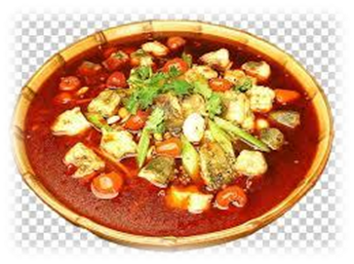
regency fluency frequency
pungency residency efficiency

Slide 18
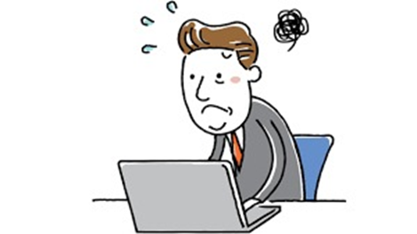
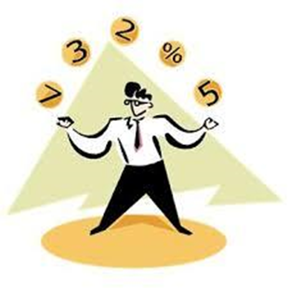
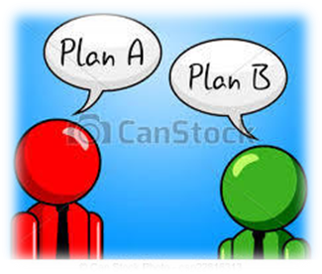
coherency incompetency proficiency
consistency contingency interdependency

Slide 19
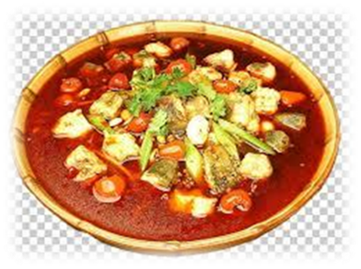

Slide 20
Activity Page:
Spelling
<-ency>

Slide 21
emergent
emergence
emergency
urgent
urgency
resident
residence
residency
frequent
frequency

Slide 22
dependent
dependence
dependency
consistent
consistency
coherent
coherence
coherency
competence
competency

Slide 23
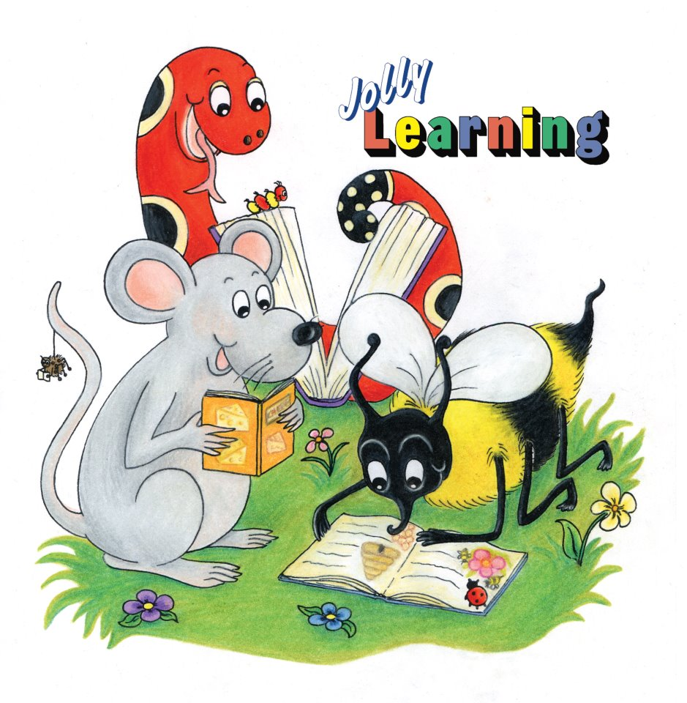
Dictation

Slide 25
The manager has a tendency to work late at the agency.

Slide 26
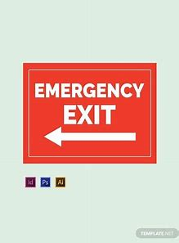
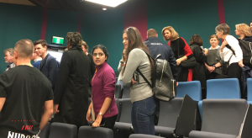

Slide 27
The audience left the building by the emergency exit.

Slide 28
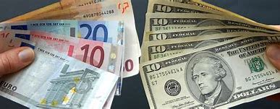

Slide 29
“Will you want to exchange any currency?” asked the travel agent.

Slide 30
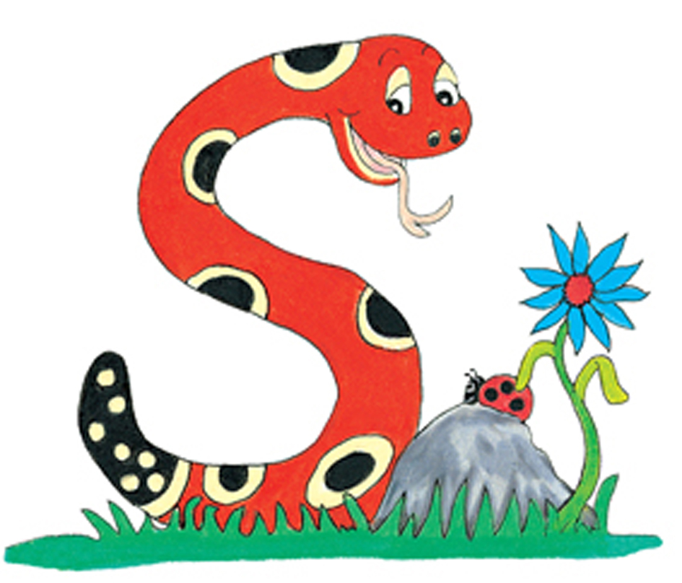
Thank you.
See you
next time!

