Slide 1
Jolly Grammar
5a-10

Slide 2
Spelling Test 5

Slide 3
absence

Slide 4
absence
silence

Slide 5
absence
silence
sentence

Slide 6
absence
silence
sentence
evidence

Slide 7
absence
silence
sentence
evidence
difference

Slide 8
absence
silence
sentence
evidence
difference
fence

Slide 9
absence
silence
sentence
evidence
difference
fence
7. existence

Slide 10
absence
silence
sentence
evidence
difference
fence
7. existence
8. coherence

Slide 11
absence
silence
sentence
evidence
difference
fence
7. existence
8. coherence
9. confidence

Slide 12
absence
silence
sentence
evidence
difference
fence
7. existence
8. coherence
9. confidence
10. eloquence

Slide 13
absence
silence
sentence
evidence
difference
fence
7. existence
8. coherence
9. confidence
10. eloquence
11. preference

Slide 14
absence
silence
sentence
evidence
difference
fence
7. existence
8. coherence
9. confidence
10. eloquence
11. preference
12. audience

Slide 15
absence
silence
sentence
evidence
difference
fence
7. existence
8. coherence
9. confidence
10. eloquence
11. preference
12. audience
13. coincidence

Slide 16
absence
silence
sentence
evidence
difference
fence
7. existence
8. coherence
9. confidence
10. eloquence
11. preference
12. audience
13. coincidence
14. emergence

Slide 17
absence
silence
sentence
evidence
difference
fence
7. existence
8. coherence
9. confidence
10. eloquence
11. preference
12. audience
13. coincidence
14. emergence
15. experience

Slide 18
absence
silence
sentence
evidence
difference
fence
7. existence
8. coherence
9. confidence
10. eloquence
11. preference
12. audience
13. coincidence
14. emergence
15. experience
16. opulence

Slide 19
absence
silence
sentence
evidence
difference
fence
7. existence
8. coherence
9. confidence
10. eloquence
11. preference
12. audience
13. coincidence
14. emergence
15. experience
16. opulence
17. intelligence

Slide 20
absence
silence
sentence
evidence
difference
fence
7. existence
8. coherence
9. confidence
10. eloquence
11. preference
12. audience
13. coincidence
14. emergence
15. experience
16. opulence
17. intelligence
18. convenience

Slide 21
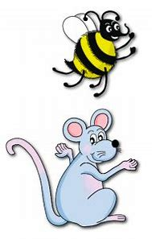
Let’s review
Personal Prouns.

Slide 22
Activity Page:
Irregular Verb
`To Have`

Slide 23
Assignment
Copy out the syllables of each spelling word (page 17).

Slide 24
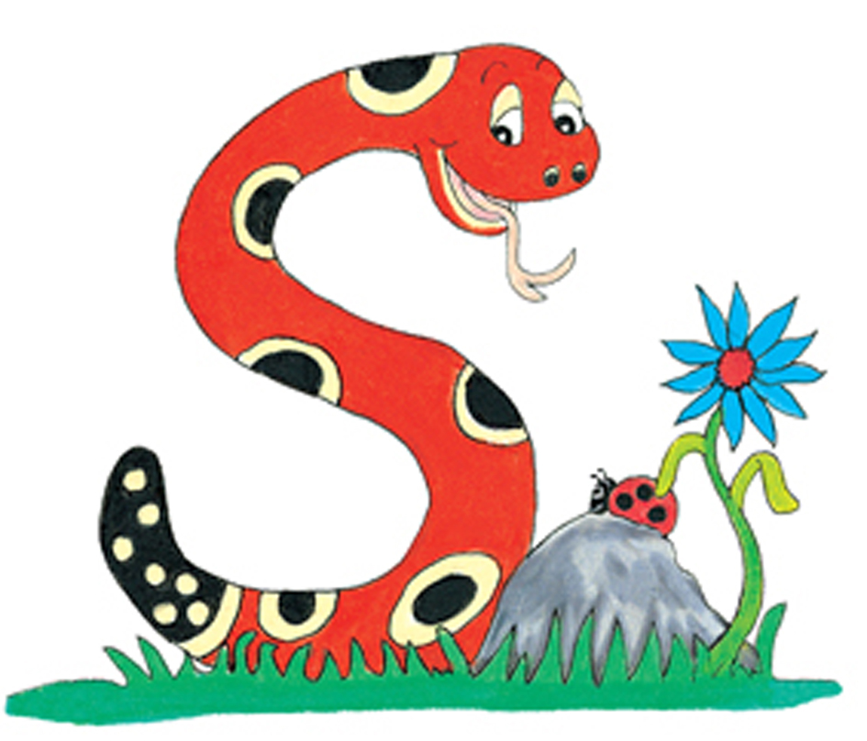
Thank you.
See you
next time!

