Slide 1
Jolly Grammar
5a-9

Slide 2
Parsing & Sentence Walls

Slide 3
The hesitant cat slowly climbs a tall tree.

Slide 4
The hesitant cat slowly climbs a tall tree.

Slide 5
The hesitant cat slowly climbs a tall tree.

Slide 6
The hesitant cat slowly climbs a tall tree.

Slide 7
The hesitant cat slowly climbs a tall tree.

Slide 8
The hesitant cat slowly climbs a tall tree.

Slide 9
The hesitant cat slowly climbs a tall tree.
Subject
cat
The hesitant
Verb
climbs
slowly
Object
tree
a tall

Slide 10
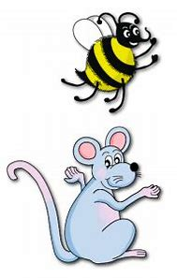
Let’s review
Soft c.

Slide 11
Activity Page
Prefixes

Slide 12
different

Slide 13
different ●

Slide 14
different ●
difference

Slide 15
different ●
difference

Slide 16
different ●
difference
confident

Slide 17
different ●
difference
confident
confidence

Slide 18
different ●
difference
confident
confidence

Slide 19
Spelling List
<-ency>

Slide 20
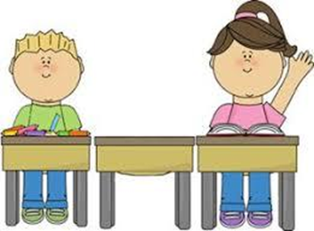
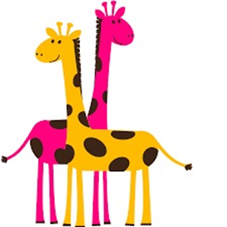
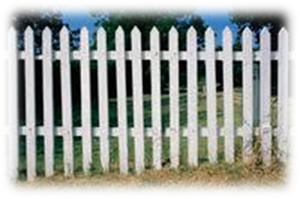
absence silence sentence
evidence difference fence

Slide 21
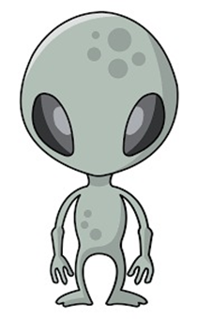
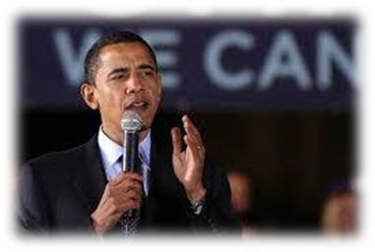
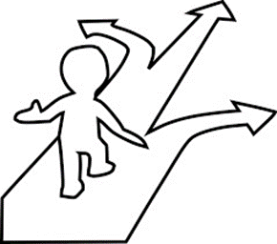
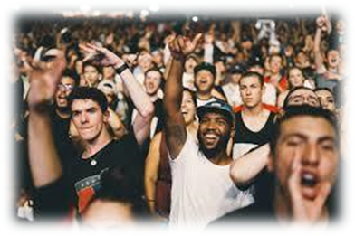
existence coherence confidence
eloquence preference audience

Slide 22
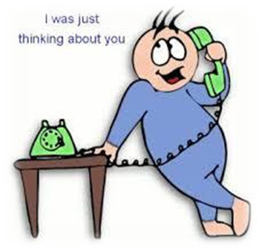
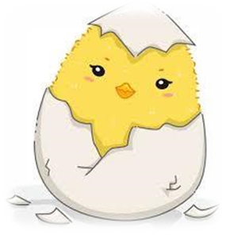
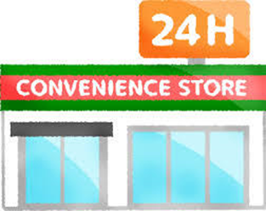
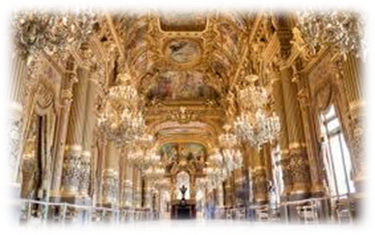
coincidence emergence experience
opulence intelligence convenience

Slide 24
Activity Page:
Spelling
<-ency>

Slide 25
clearance

Slide 26
clearance
confidence

Slide 27
clearance
confidence
annoyance

Slide 28
clearance
confidence
annoyance
assistance

Slide 29
clearance
confidence
annoyance
assistance
guidance

Slide 30
clearance
confidence
annoyance
assistance
guidance
preference

Slide 31
clearance
confidence
annoyance
assistance
guidance
preference
acceptance

Slide 32
clearance
confidence
annoyance
assistance
guidance
preference
acceptance
difference

Slide 33
clearance
confidence
annoyance
assistance
guidance
preference
acceptance
difference
emergence

Slide 34
clearance
confidence
annoyance
assistance
guidance
preference
acceptance
difference
emergence
existence

Slide 35
audience

Slide 36
audience
disappearance

Slide 37
audience
disappearance
disturbance

Slide 38
audience
disappearance
disturbance
attendance

Slide 39
audience
disappearance
disturbance
attendance
eloquence

Slide 40
audience
disappearance
disturbance
attendance
eloquence
opulence

Slide 41
audience
disappearance
disturbance
attendance
eloquence
opulence
acquaintance

Slide 42
audience
disappearance
disturbance
attendance
eloquence
opulence
acquaintance
coincidence

Slide 43
audience
disappearance
disturbance
attendance
eloquence
opulence
acquaintance
coincidence
coherence

Slide 44
audience
disappearance
disturbance
attendance
eloquence
opulence
acquaintance
coincidence
coherence
absence

Slide 45
audience
disappearance
disturbance
attendance
eloquence
opulence
acquaintance
coincidence
coherence
absence
brilliance

Slide 46
audience
disappearance
disturbance
attendance
eloquence
opulence
acquaintance
coincidence
coherence
absence
brilliance
advance

Slide 47
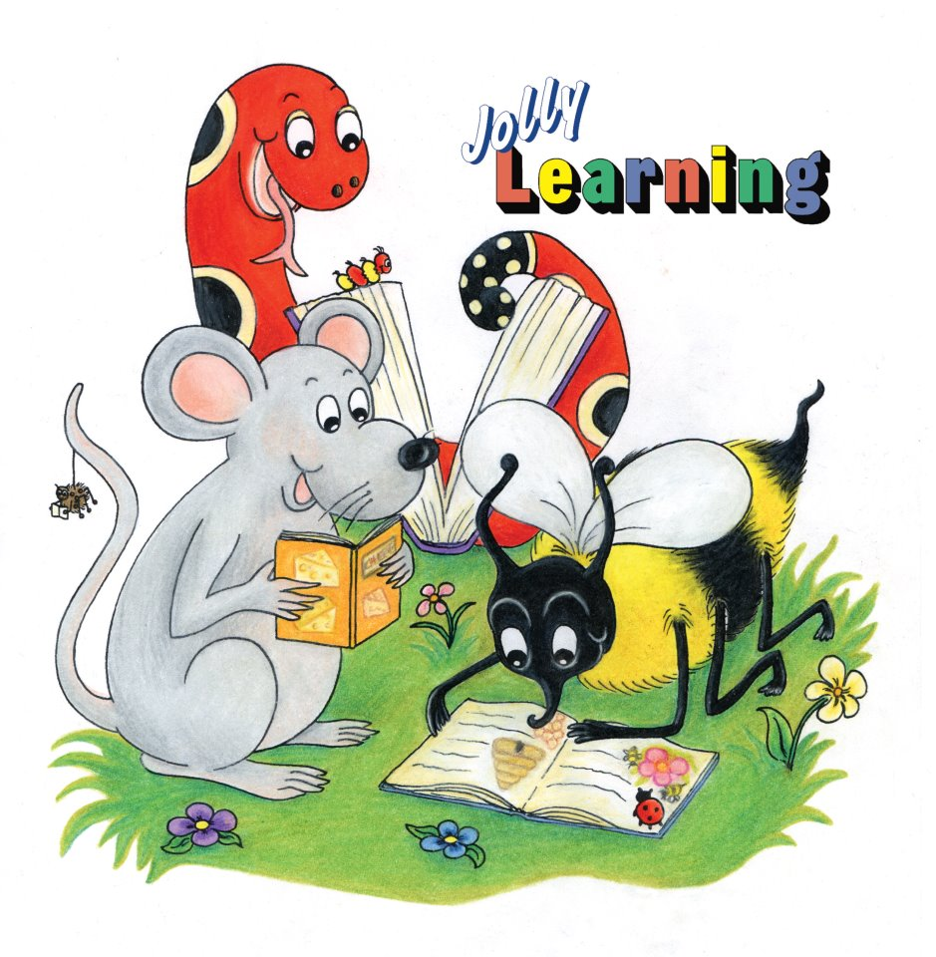
Dictation

Slide 48
“The orange dress is my preference,” admitted the customer.

Slide 49
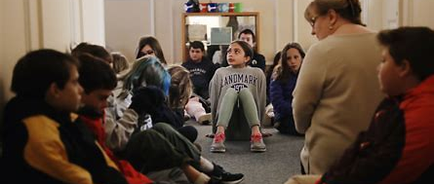
They waited in silence during her absence.

Slide 50
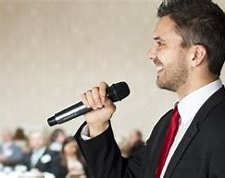
He spoke with great eloquence about his recent experience.

Slide 51
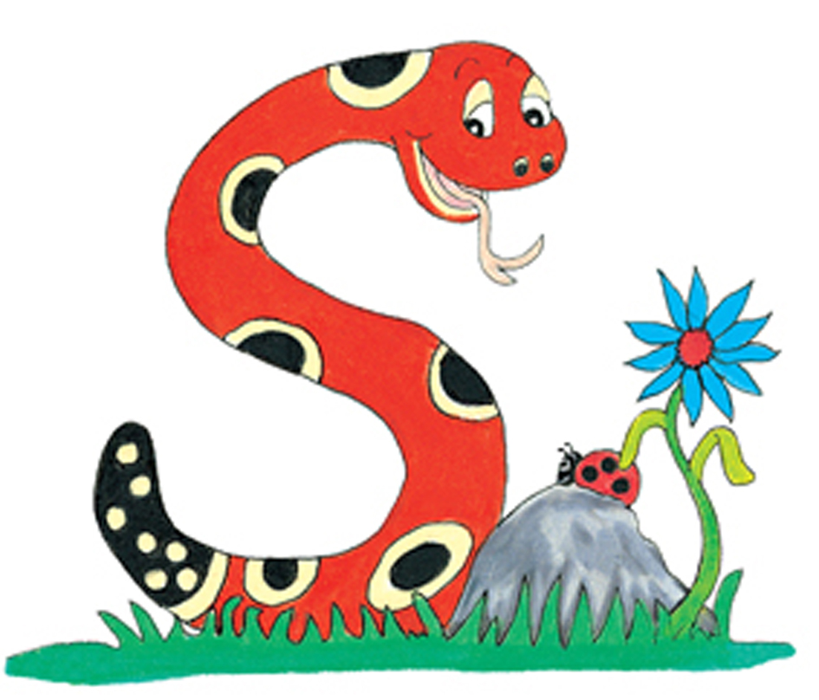
Thank you.
See you
next time!

