Slide 1
Jolly Grammar
5a-8

Slide 2
Spelling Test 4

Slide 3
infancy

Slide 4
infancy
vacancy

Slide 5
infancy
vacancy
vibrancy

Slide 6
infancy
vacancy
vibrancy
constancy

Slide 7
infancy
vacancy
vibrancy
constancy
hesitancy

Slide 8
infancy
vacancy
vibrancy
constancy
hesitancy
relevancy

Slide 9
infancy
vacancy
vibrancy
constancy
hesitancy
relevancy
7. consultancy

Slide 10
infancy
vacancy
vibrancy
constancy
hesitancy
relevancy
7. consultancy
8. discrepancy

Slide 11
infancy
vacancy
vibrancy
constancy
hesitancy
relevancy
7. consultancy
8. discrepancy
9. flippancy

Slide 12
infancy
vacancy
vibrancy
constancy
hesitancy
relevancy
7. consultancy
8. discrepancy
9. flippancy
10. pregnancy

Slide 13
infancy
vacancy
vibrancy
constancy
hesitancy
relevancy
7. consultancy
8. discrepancy
9. flippancy
10. pregnancy
11. expectancy

Slide 14
infancy
vacancy
vibrancy
constancy
hesitancy
relevancy
7. consultancy
8. discrepancy
9. flippancy
10. pregnancy
11. expectancy
12. dormancy

Slide 15
infancy
vacancy
vibrancy
constancy
hesitancy
relevancy
7. consultancy
8. discrepancy
9. flippancy
10. pregnancy
11. expectancy
12. dormancy
13. poignancy

Slide 16
infancy
vacancy
vibrancy
constancy
hesitancy
relevancy
7. consultancy
8. discrepancy
9. flippancy
10. pregnancy
11. expectancy
12. dormancy
13. poignancy
14. truancy

Slide 17
infancy
vacancy
vibrancy
constancy
hesitancy
relevancy
7. consultancy
8. discrepancy
9. flippancy
10. pregnancy
11. expectancy
12. dormancy
13. poignancy
14. truancy
15. occupancy

Slide 18
infancy
vacancy
vibrancy
constancy
hesitancy
relevancy
7. consultancy
8. discrepancy
9. flippancy
10. pregnancy
11. expectancy
12. dormancy
13. poignancy
14. truancy
15. occupancy
16. piquancy

Slide 19
infancy
vacancy
vibrancy
constancy
hesitancy
relevancy
7. consultancy
8. discrepancy
9. flippancy
10. pregnancy
11. expectancy
12. dormancy
13. poignancy
14. truancy
15. occupancy
16. piquancy
17. buoyancy

Slide 20
infancy
vacancy
vibrancy
constancy
hesitancy
relevancy
7. consultancy
8. discrepancy
9. flippancy
10. pregnancy
11. expectancy
12. dormancy
13. poignancy
14. truancy
15. occupancy
16. piquancy
17. buoyancy
18. malignancy

Slide 21
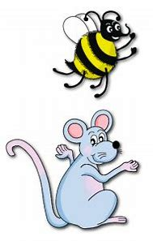
Let’s review
Verb Tenses.

Slide 22
Activity Page:
Verb Tenses

Slide 23
Assignment
Copy out the syllables of each spelling word (page 11).

Slide 24
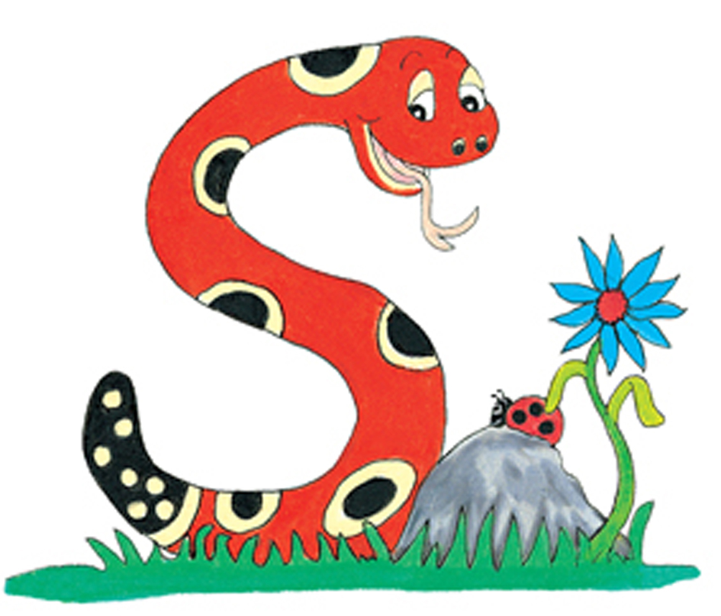
Thank you.
See you
next time!

