Slide 1
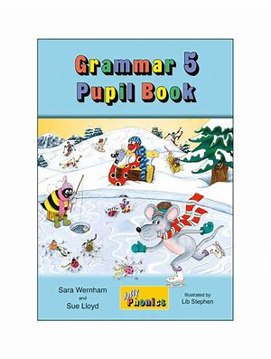
Jolly Grammar
5a-7

Slide 2
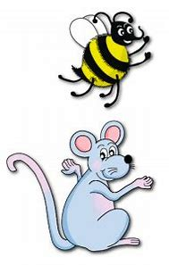
Let’s review
Soft c.

Slide 3
Activity Page
Prefixes

Slide 4
relevant
relevance
relevancy

Slide 5
relevant ●
relevance
relevancy

Slide 6
relevant ●
relevance ●
relevancy

Slide 7
relevant ●
relevance ●
relevancy ●

Slide 8
The hotel has a vacancy.
The hotel has a vacant room.

Slide 9
Spelling List
<-ancy>

Slide 10
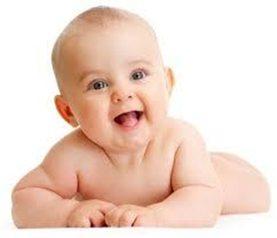
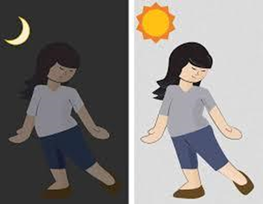
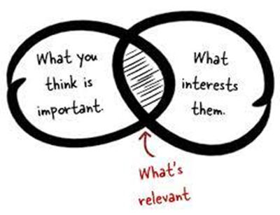
infancy vacancy vibrancy
constancy hesitancy relevancy

Slide 11
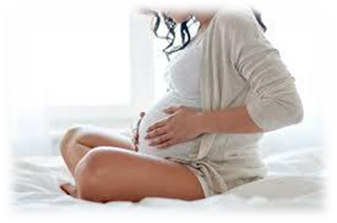
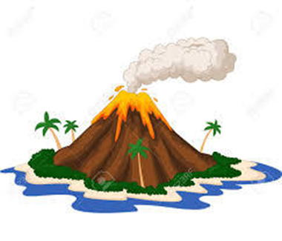
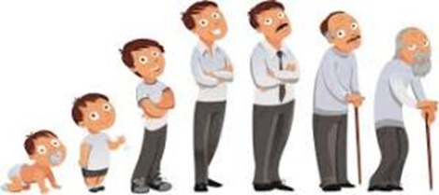
consultancy discrepancy flippancy
pregnancy expectancy dormancy

Slide 12
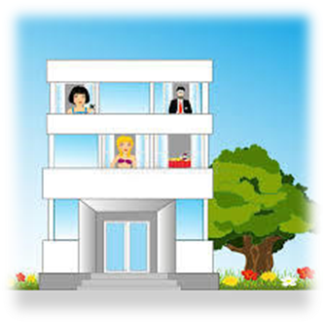
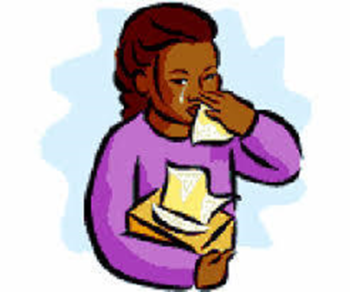
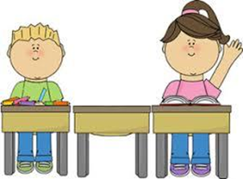
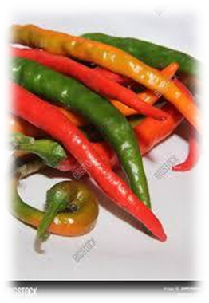
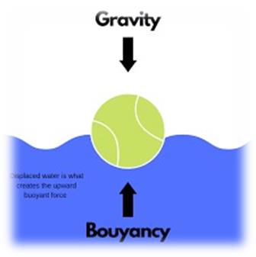
poignancy truancy occupancy
piquancy buoyancy malignancy

Slide 13
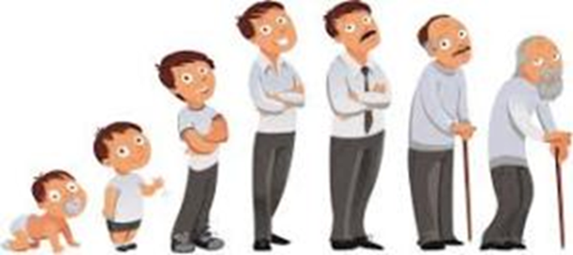
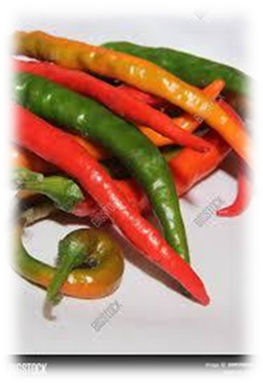

Slide 14
Activity Page:
Spelling
<-ancy>

Slide 15
consultant
consultancy
hesitant
hesitance
hesitancy
flippant
flippancy
buoyant
buoyancy
malignant
malignancy
vacant
vacancy
piquant
piquancy
occupant
occupancy
vibrant
vibrancy
relevance
relevancy
expectant
expectancy

Slide 16
Parsing & Sentence Walls

Slide 17
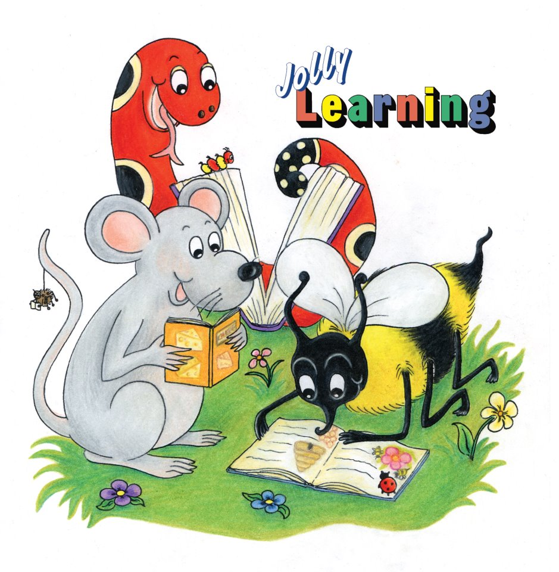
Dictation

Slide 18
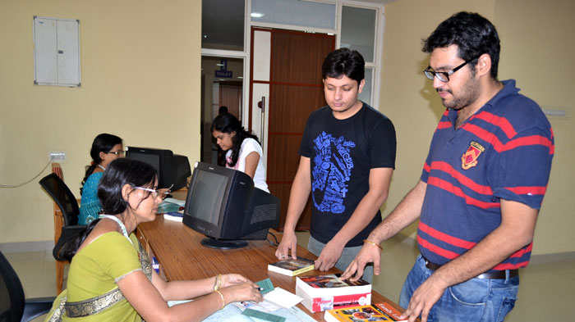
There is a vacancy for an assistant in the village library.

Slide 19
She waited with great expectancy during her pregnancy.

Slide 20
“There is discrepancy in the accounts,” said the accountant.

Slide 21
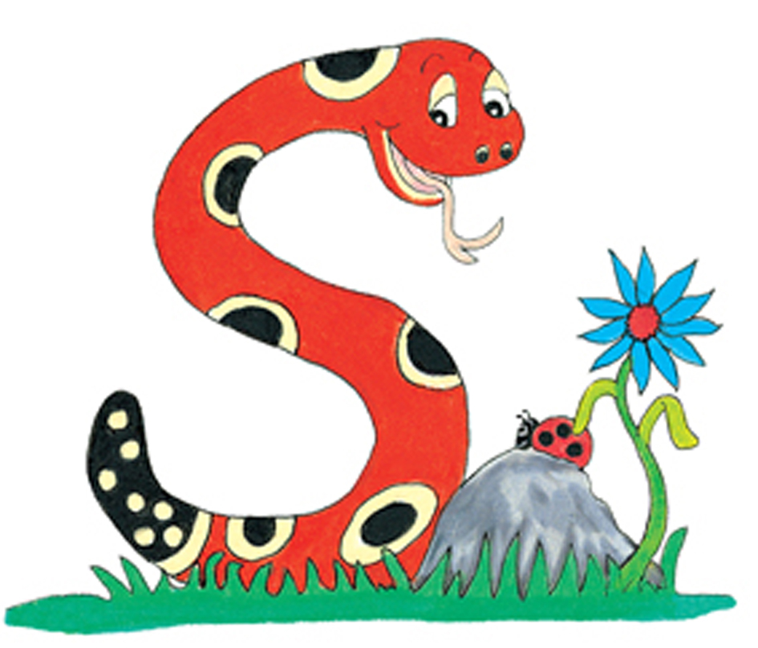
Thank you.
See you
next time!

