Slide 1
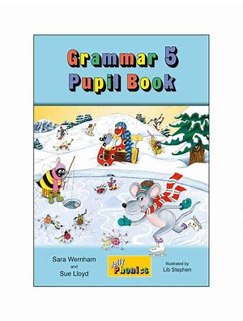
Jolly Grammar
5a-6

Slide 2
Spelling Test 3

Slide 3
distance

Slide 4
distance
advance

Slide 5
distance
advance
balance

Slide 6
distance
advance
balance
entrance

Slide 7
distance
advance
balance
entrance
chance

Slide 8
distance
advance
balance
entrance
chance
acceptance

Slide 9
distance
advance
balance
entrance
chance
acceptance
7. admittance

Slide 10
distance
advance
balance
entrance
chance
acceptance
7. admittance
8. annoyance

Slide 11
distance
advance
balance
entrance
chance
acceptance
7. admittance
8. annoyance
9. assistance

Slide 12
distance
advance
balance
entrance
chance
acceptance
7. admittance
8. annoyance
9. assistance
10. clearance

Slide 13
distance
advance
balance
entrance
chance
acceptance
7. admittance
8. annoyance
9. assistance
10. clearance
11. disturbance

Slide 14
distance
advance
balance
entrance
chance
acceptance
7. admittance
8. annoyance
9. assistance
10. clearance
11. disturbance
12. fragrance

Slide 15
distance
advance
balance
entrance
chance
acceptance
7. admittance
8. annoyance
9. assistance
10. clearance
11. disturbance
12. fragrance
13. allegiance

Slide 16
distance
advance
balance
entrance
chance
acceptance
7. admittance
8. annoyance
9. assistance
10. clearance
11. disturbance
12. fragrance
13. allegiance
14. guidance

Slide 17
distance
advance
balance
entrance
chance
acceptance
7. admittance
8. annoyance
9. assistance
10. clearance
11. disturbance
12. fragrance
13. allegiance
14. guidance
15. nuisance

Slide 18
distance
advance
balance
entrance
chance
acceptance
7. admittance
8. annoyance
9. assistance
10. clearance
11. disturbance
12. fragrance
13. allegiance
14. guidance
15. nuisance
16. hindrance

Slide 19
distance
advance
balance
entrance
chance
acceptance
7. admittance
8. annoyance
9. assistance
10. clearance
11. disturbance
12. fragrance
13. allegiance
14. guidance
15. nuisance
16. hindrance
17. irrelevance

Slide 20
distance
advance
balance
entrance
chance
acceptance
7. admittance
8. annoyance
9. assistance
10. clearance
11. disturbance
12. fragrance
13. allegiance
14. guidance
15. nuisance
16. hindrance
17. irrelevance
18. acquaintance

Slide 21
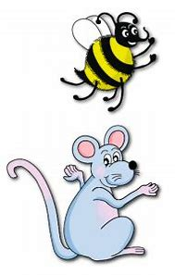
Let’s review
Parts of Speech,
S & O.

Slide 22
Activity Page:
Sentence Walls

Slide 23
Assignment
Copy out the syllables of each spelling word (page 11).

Slide 24
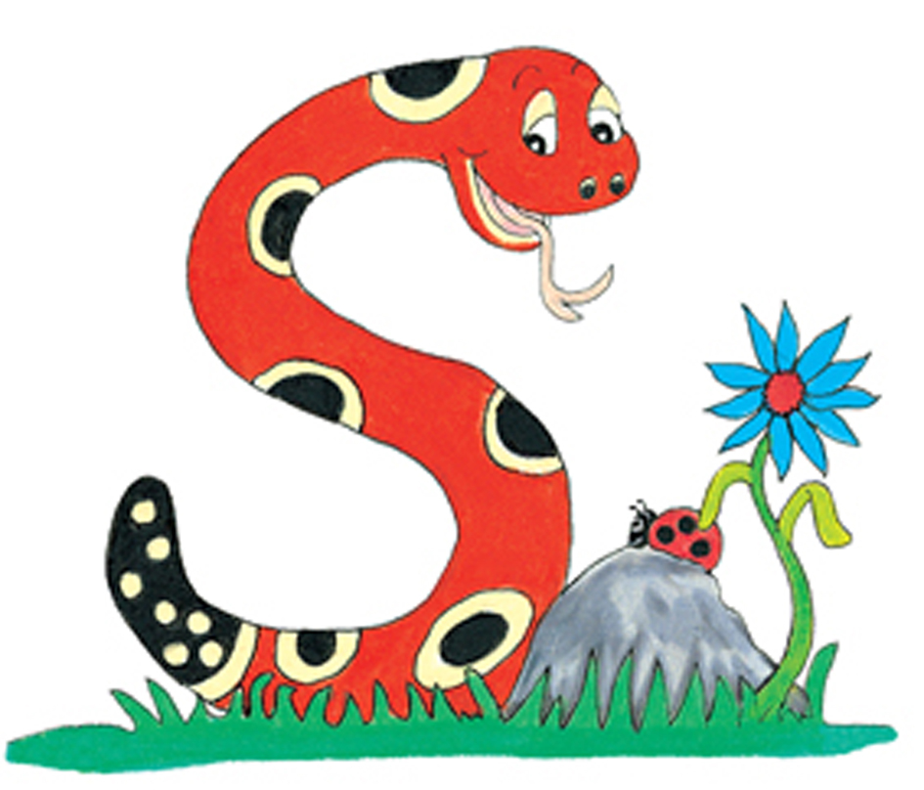
Thank you.
See you
next time!

