Slide 1
Jolly Grammar
5a-3

Slide 2
Let’s review
Prefixes.

Slide 3
Activity Page
Prefixes

Slide 4
prehistoric
subway
transfer/
prefer
antibiotic
transport/
teleport
interactive
submarine
prepare
telephone

Slide 5
Spelling Point

Slide 6
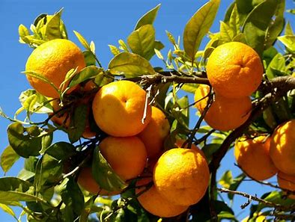
orange

Slide 7
Spelling List
<nge>

Slide 8
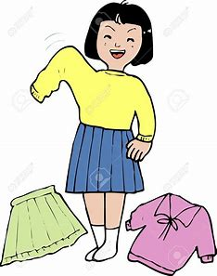
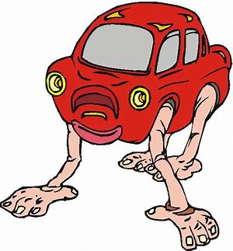
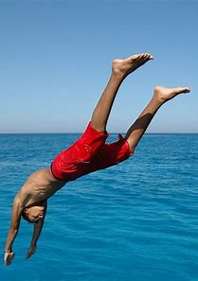
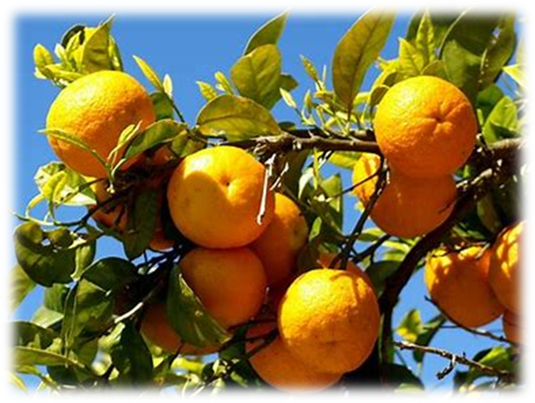
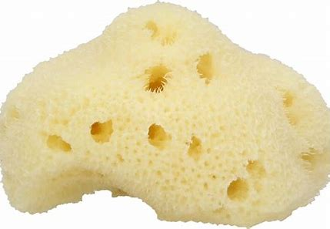
change strange challenge
orange plunge sponge

Slide 9
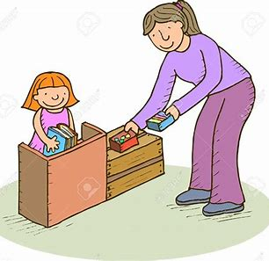
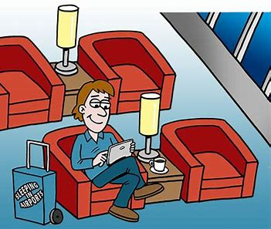
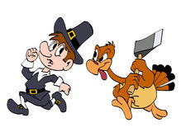
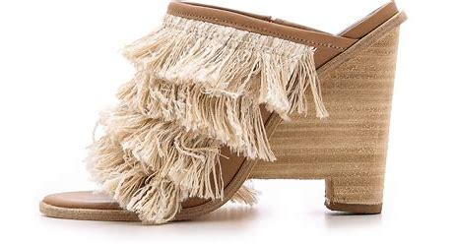
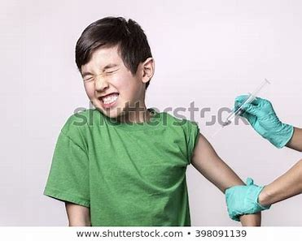
exchange arrange lounge
fringe revenge cringe

Slide 10
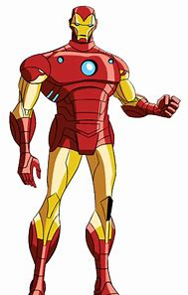
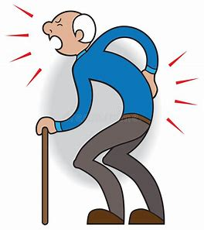
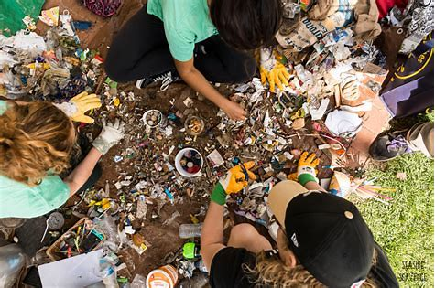
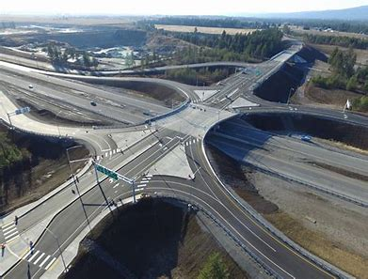
syringe avenge twinge
singe scavenge interchange

Slide 11
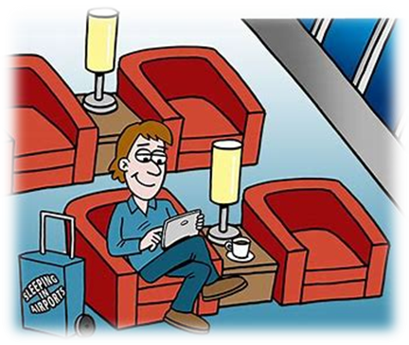
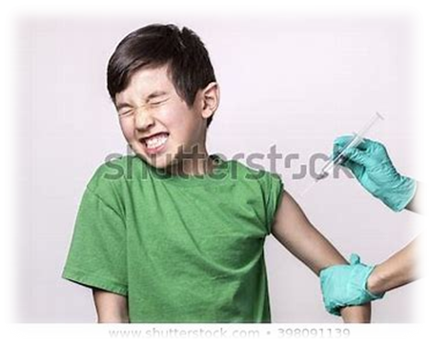
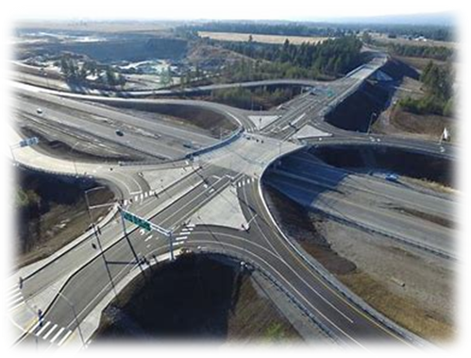
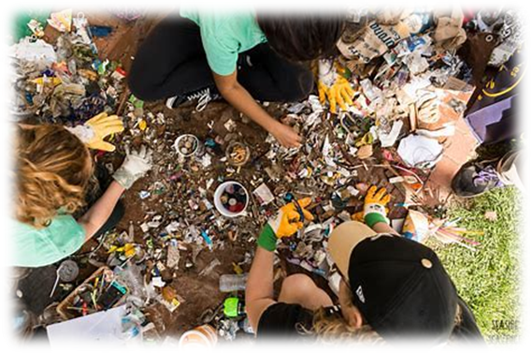

Slide 12
Activity Page:
Making sentences

Slide 13
parsing

Slide 14
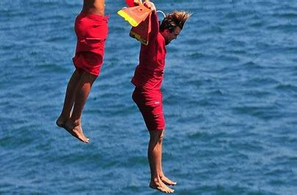
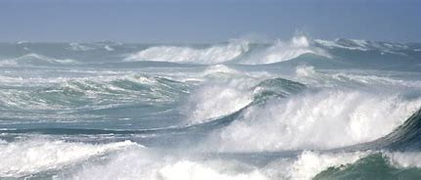
The brave lifeguard plunges fearlessly into the choppy waters.

Slide 15
The brave lifeguard plunges fearlessly into the choppy waters.

Slide 16
The brave lifeguard plunges fearlessly into the choppy waters.

Slide 17
The brave lifeguard plunges fearlessly into the choppy waters.

Slide 18
The brave lifeguard plunges fearlessly into the choppy waters.

Slide 19
The brave lifeguard plunges fearlessly into the choppy waters.

Slide 20
The brave lifeguard plunges fearlessly into the choppy waters.

Slide 21
The brave lifeguard plunges fearlessly into the choppy waters.

Slide 22
The brave lifeguard plunges fearlessly into the choppy waters.
3rd person singular
Simple present

Slide 23
Dictation

Slide 24
“The fringe is singed!” exclaimed the stranger.

Slide 25
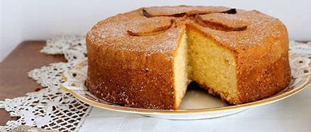
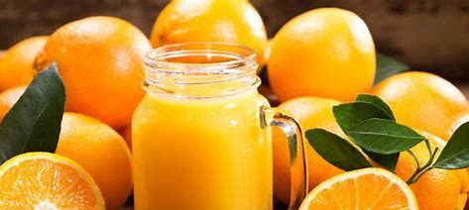
The children had sponge cake and a drink of orange.

Slide 26
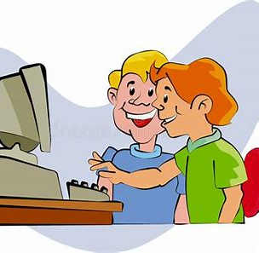
They arranged to exchange messages on the internet.

Slide 27
Thank you.
See you
next time!

