Slide 1
Jolly Grammar
5a-2

Slide 2
Spelling Test 1

Slide 3
college

Slide 4
college
privilege

Slide 5
college
privilege
allege

Slide 6
college
privilege
allege
manage

Slide 7
college
privilege
allege
manage
cottage

Slide 8
college
privilege
allege
manage
cottage
village

Slide 9
college
privilege
allege
manage
cottage
village
7.message

Slide 10
college
privilege
allege
manage
cottage
village
7.message
8.advantage

Slide 11
college
privilege
allege
manage
cottage
village
7.message
8.advantage
9.damage

Slide 12
college
privilege
allege
manage
cottage
village
7.message
8.advantage
9.damage
10.heritage

Slide 13
college
privilege
allege
manage
cottage
village
7.message
8.advantage
9.damage
10.heritage
11.average

Slide 14
college
privilege
allege
manage
cottage
village
7.message
8.advantage
9.damage
10.heritage
11.average
12.savage

Slide 15
college
privilege
allege
manage
cottage
village
7.message
8.advantage
9.damage
10.heritage
11.average
12.savage
13.courage

Slide 16
college
privilege
allege
manage
cottage
village
7.message
8.advantage
9.damage
10.heritage
11.average
12.savage
13.courage
14.wreckage

Slide 17
college
privilege
allege
manage
cottage
village
7.message
8.advantage
9.damage
10.heritage
11.average
12.savage
13.courage
14.wreckage
15.sausage

Slide 18
college
privilege
allege
manage
cottage
village
7.message
8.advantage
9.damage
10.heritage
11.average
12.savage
13.courage
14.wreckage
15.sausage
16.language

Slide 19
college
privilege
allege
manage
cottage
village
7.message
8.advantage
9.damage
10.heritage
11.average
12.savage
13.courage
14.wreckage
15.sausage
16.language
17.orphanage

Slide 20
college
privilege
allege
manage
cottage
village
7.message
8.advantage
9.damage
10.heritage
11.average
12.savage
13.courage
14.wreckage
15.sausage
16.language
17.orphanage
18.marriage

Slide 21
Let’s review
Parts of Speech.

Slide 22
Activity Page:
Parts of Speech and Parsing

Slide 23
Doing words that can describe the past, present or future:
Names of people, places, dates or things:
Words that describes nouns and pronouns:
Words that describes verbs:
Small words that take the place of nouns:
Words that join parts of a sentence together:
Words that relate one noun or pronoun to another:

Slide 24
Doing words that can describe the past, present or future: Verbs
Names of people, places, dates or things:
Words that describes nouns and pronouns:
Words that describes verbs:
Small words that take the place of nouns:
Words that join parts of a sentence together:
Words that relate one noun or pronoun to another:

Slide 25
Doing words that can describe the past, present or future: Verbs
Names of people, places, dates or things: Nouns
Words that describes nouns and pronouns:
Words that describes verbs:
Small words that take the place of nouns:
Words that join parts of a sentence together:
Words that relate one noun or pronoun to another:

Slide 26
Doing words that can describe the past, present or future: Verbs
Names of people, places, dates or things: Nouns
Words that describes nouns and pronouns: Adjective
Words that describes verbs:
Small words that take the place of nouns:
Words that join parts of a sentence together:
Words that relate one noun or pronoun to another:

Slide 27
Doing words that can describe the past, present or future: Verbs
Names of people, places, dates or things: Nouns
Words that describes nouns and pronouns: Adjective
Words that describes verbs: Adverbs
Small words that take the place of nouns:
Words that join parts of a sentence together:
Words that relate one noun or pronoun to another:

Slide 28
Doing words that can describe the past, present or future: Verbs
Names of people, places, dates or things: Nouns
Words that describes nouns and pronouns: Adjective
Words that describes verbs: Adverbs
Small words that take the place of nouns: Pronouns
Words that join parts of a sentence together:
Words that relate one noun or pronoun to another:

Slide 29
Doing words that can describe the past, present or future: Verbs
Names of people, places, dates or things: Nouns
Words that describes nouns and pronouns: Adjective
Words that describes verbs: Adverbs
Small words that take the place of nouns: Pronouns
Words that join parts of a sentence together: Conjunctions
Words that relate one noun or pronoun to another:

Slide 30
Doing words that can describe the past, present or future: Verbs
Names of people, places, dates or things: Nouns
Words that describes nouns and pronouns: Adjective
Words that describes verbs: Adverbs
Small words that take the place of nouns: Pronouns
Words that join parts of a sentence together: Conjunctions
Words that relate one noun or pronoun to another: Prepositions

Slide 31
parsing

Slide 32
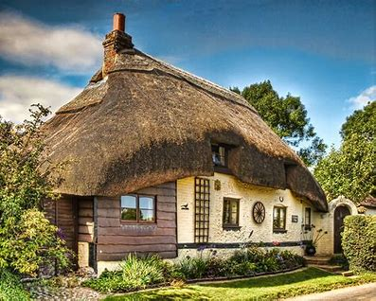
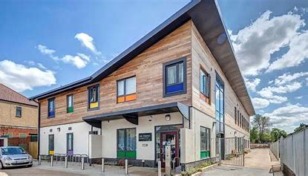
We live in a pretty thatched cottage near the village school.

Slide 33
We live in a pretty thatched cottage near the village school.

Slide 34
The yellow submarine dived gracefully under the waves and disappeared from view.

Slide 35
The yellow submarine dived gracefully under the waves and disappeared from view.

Slide 36
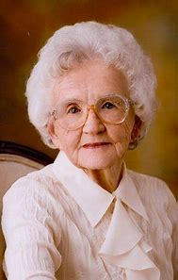
Zack’s grandma had a big party on her eightieth birthday.

Slide 37
Zack’s grandma had a big party on her eightieth birthday.

Slide 38
Complete the sentences.

Slide 39
She knitted me a red, fluffy and warm scarf for my birthday.
The small mouse ran hurriedly over the hedge and into the field.
The big tree had a big crop of corn this year.

Slide 40
Assignment
Copy out the syllables of each spelling word (page 5).

Slide 41
Thank you.
See you
next time!

