Slide 1
Jolly Grammar
4-36

Slide 2
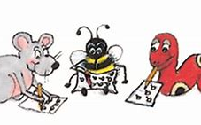
Spelling Test 35

Slide 3
interact

Slide 4
interact
interval

Slide 5
interact
interval
intersect

Slide 6
interact
interval
intersect
internet

Slide 7
interact
interval
intersect
internet
interlock

Slide 8
interact
interval
intersect
internet
interlock
interlude

Slide 9
interact
interval
intersect
internet
interlock
interlude
7.interactive

Slide 10
interact
interval
intersect
internet
interlock
interlude
7.interactive
8.interview

Slide 11
interact
interval
intersect
internet
interlock
interlude
7.interactive
8.interview
9.interject

Slide 12
interact
interval
intersect
internet
interlock
interlude
7.interactive
8.interview
9.interject
10.intervene

Slide 13
interact
interval
intersect
internet
interlock
interlude
7.interactive
8.interview
9.interject
10.intervene
11.interpreter

Slide 14
interact
interval
intersect
internet
interlock
interlude
7.interactive
8.interview
9.interject
10.intervene
11.interpreter
12.interchange

Slide 15
interact
interval
intersect
internet
interlock
interlude
7.interactive
8.interview
9.interject
10.intervene
11.interpreter
12.interchange
13.interloper

Slide 16
interact
interval
intersect
internet
interlock
interlude
7.interactive
8.interview
9.interject
10.intervene
11.interpreter
12.interchange
13.interloper
14.interfere

Slide 17
interact
interval
intersect
internet
interlock
interlude
7.interactive
8.interview
9.interject
10.intervene
11.interpreter
12.interchange
13.interloper
14.interfere
15.intercept

Slide 18
interact
interval
intersect
internet
interlock
interlude
7.interactive
8.interview
9.interject
10.intervene
11.interpreter
12.interchange
13.interloper
14.interfere
15.intercept
16.interweave

Slide 19
interact
interval
intersect
internet
interlock
interlude
7.interactive
8.interview
9.interject
10.intervene
11.interpreter
12.interchange
13.interloper
14.interfere
15.intercept
16.interweave
17.intermittent

Slide 20
interact
interval
intersect
internet
interlock
interlude
7.interactive
8.interview
9.interject
10.intervene
11.interpreter
12.interchange
13.interloper
14.interfere
15.intercept
16.interweave
17.intermittent
18.international

Slide 21
Let’s review
Homophones.

Slide 22
waste: We don’t have much water left.
Don’t waste it.
waist: My waist is bigger than yours.

Slide 23
waste: We don’t have much water left.
Don’t waste it.
waist: My waist is bigger than yours.
groan: He is groaning when he is in pain.
grown: She has grown so much.

Slide 24
waste: We don’t have much water left.
Don’t waste it.
waist: My waist is bigger than yours.
groan: He is groaning when he is in pain.
grown: She has grown so much.
boulder: Look at this boulder. It’s really big.
bolder: She is bolder in front of the audience.

Slide 25
Changing Verb Tenses.

Slide 26
He danced to the music.

Slide 27
He danced to the music.
He dances to the music.

Slide 28
He danced to the music.
He dances to the music.
He will dance to the music.

Slide 29
He danced to the music.
He dances to the music.
He will dance to the music.
He was dancing to the music.

Slide 30
He danced to the music.
He dances to the music.
He will dance to the music.
He was dancing to the music.
He is dancing to the music.

Slide 31
He danced to the music.
He dances to the music.
He will dance to the music.
He was dancing to the music.
He is dancing to the music.
He will be dancing to the music.

Slide 32
Activity Page
Spelling <tele->

Slide 33
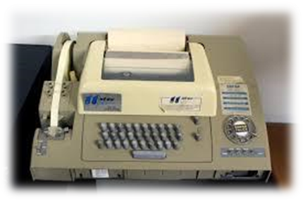
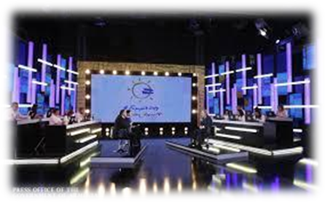
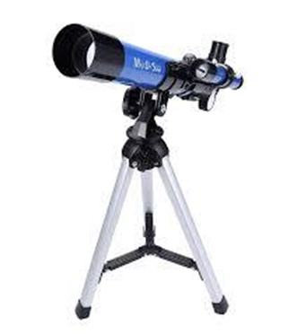
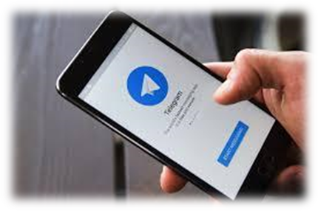
telex telecast telethon
telegram teleport telescope

Slide 34
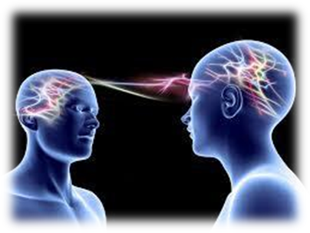
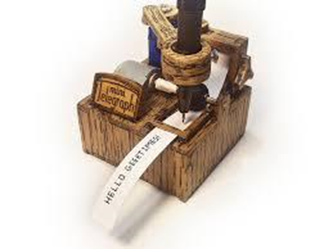
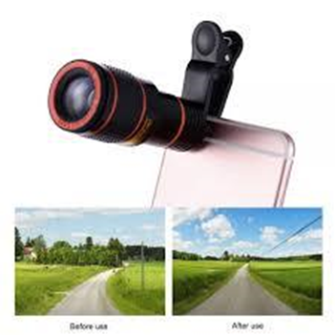
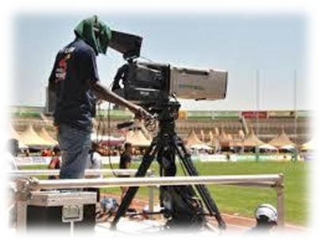
telepathic telegraph telephone
telephoto televise telepathy

Slide 35
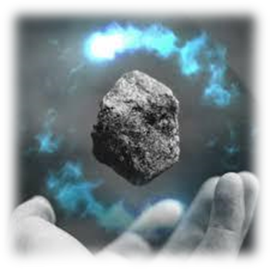
telescopic television telekinesis
teleconference telecommuting telemarketing

Slide 36
t e l e c o m m u n I c a t I o n s

Slide 37
t e l e c o m m u n I c a t i o n s
tent

Slide 38
parsing

Slide 39
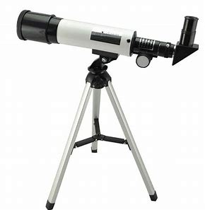
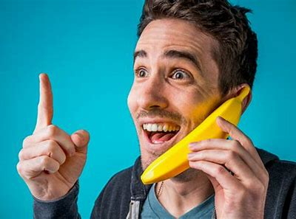
I will tell you about the fantastic telescope over the telephone.

Slide 40
I will tell you about the fantastic telescope over the telephone.

Slide 41
I will tell you about the fantastic telescope over the telephone.

Slide 42
I will tell you about the fantastic telescope over the telephone.

Slide 43
I will tell you about the fantastic telescope over the telephone.

Slide 44
I will tell you about the fantastic telescope over the telephone.

Slide 45
I will tell you about the fantastic telescope over the telephone.

Slide 46
I will tell you about the fantastic telescope over the telephone.

Slide 47
I will tell you about the fantastic telescope over the telephone.

Slide 48
I will tell you about the fantastic telescope over the telephone.
1st person singular
Simple future

Slide 49
Dictation

Slide 50
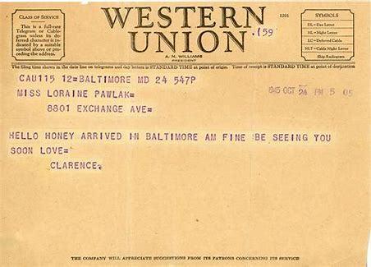
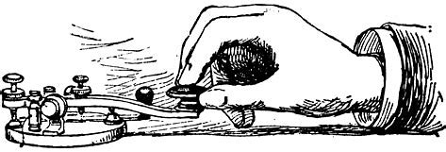
Telegrams were used to report important events.

Slide 51
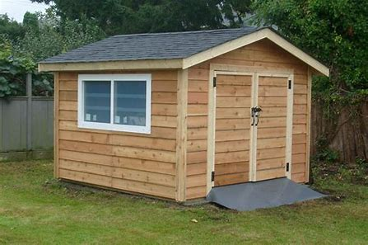
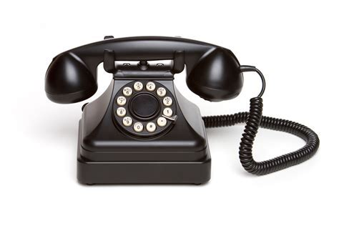
“I found an old telephone in the shed,” said Sam.

Slide 52
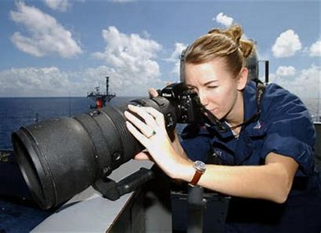
She bought a telephoto lens for her new camera.

Slide 53
Thank you.
See you
next time!

