Slide 1
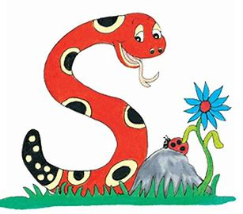
Jolly Grammar
4-35

Slide 2
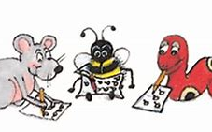
Spelling Test 34

Slide 3
transport

Slide 4
transport
transfer

Slide 5
transport
transfer
transmit

Slide 6
transport
transfer
transmit
transept

Slide 7
transport
transfer
transmit
transept
transit

Slide 8
transport
transfer
transmit
transept
transit
translate

Slide 9
transport
transfer
transmit
transept
transit
translate
7.transpose

Slide 10
transport
transfer
transmit
transept
transit
translate
7.transpose
8.transverse

Slide 11
transport
transfer
transmit
transept
transit
translate
7.transpose
8.transverse
9.transmitter

Slide 12
transport
transfer
transmit
transept
transit
translate
7.transpose
8.transverse
9.transmitter
10.transcend

Slide 13
transport
transfer
transmit
transept
transit
translate
7.transpose
8.transverse
9.transmitter
10.transcend
11.transplant

Slide 14
transport
transfer
transmit
transept
transit
translate
7.transpose
8.transverse
9.transmitter
10.transcend
11.transplant
12.transaction

Slide 15
transport
transfer
transmit
transept
transit
translate
7.transpose
8.transverse
9.transmitter
10.transcend
11.transplant
12.transaction
13.transitory

Slide 16
transport
transfer
transmit
transept
transit
translate
7.transpose
8.transverse
9.transmitter
10.transcend
11.transplant
12.transaction
13.transitory
14.transfusion

Slide 17
transport
transfer
transmit
transept
transit
translate
7.transpose
8.transverse
9.transmitter
10.transcend
11.transplant
12.transaction
13.transitory
14.transfusion
15.transparent

Slide 18
transport
transfer
transmit
transept
transit
translate
7.transpose
8.transverse
9.transmitter
10.transcend
11.transplant
12.transaction
13.transitory
14.transfusion
15.transparent
16.translation

Slide 19
transport
transfer
transmit
transept
transit
translate
7.transpose
8.transverse
9.transmitter
10.transcend
11.transplant
12.transaction
13.transitory
14.transfusion
15.transparent
16.translation
17.transferable

Slide 20
transport
transfer
transmit
transept
transit
translate
7.transpose
8.transverse
9.transmitter
10.transcend
11.transplant
12.transaction
13.transitory
14.transfusion
15.transparent
16.translation
17.transferable
18.transformation

Slide 21
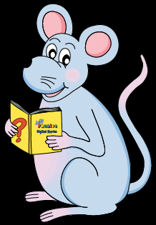
Let’s review
Questions and punctuation.

Slide 22
Let’s review
Homophones.

Slide 23
① you’re ② your
Is it time for piano practice?
After lunch going for a walk.

Slide 24
① you’re ② your
Is it time for your piano practice?
After lunch going for a walk.

Slide 25
① you’re ② your
Is it time for your piano practice?
After lunch you’re going for a walk.

Slide 26
① wear ② were ③ where
would you like to go on Saturday?
I will my blue shoes to the wedding.
We all happy to do the fun run.

Slide 27
① wear ② were ③ where
Where would you like to go on Saturday?
I will my blue shoes to the wedding.
We all happy to do the fun run.

Slide 28
① wear ② were ③ where
Where would you like to go on Saturday?
I will wear my blue shoes to the wedding.
We all happy to do the fun run.

Slide 29
① wear ② were ③ where
Where would you like to go on Saturday?
I will wear my blue shoes to the wedding.
We were all happy to do the fun run.

Slide 30
① to ② too ③ two
The twins wanted help, .

Slide 31
① to ② too ③ two
The two twins wanted help, .

Slide 32
① to ② too ③ two
The two twins wanted to help, .

Slide 33
① to ② too ③ two
The two twins wanted to help, too .

Slide 34
① there ② they’re ③ their
Suddenly was a loud explosion.
The girls have swimming lessons this weekend.
Tomorrow afternoon going to the theme park.

Slide 35
① there ② they’re ③ their
Suddenly there was a loud explosion.
The girls have swimming lessons this weekend.
Tomorrow afternoon going to the theme park.

Slide 36
① there ② they’re ③ their
Suddenly there was a loud explosion.
The girls have their swimming lessons this weekend.
Tomorrow afternoon going to the theme park.

Slide 37
① there ② they’re ③ their
Suddenly there was a loud explosion.
The girls have their swimming lessons this weekend.
Tomorrow afternoon they’re going to the theme park.

Slide 38
① it’s ② its
The puppy ran around, chasing tail.
such a lovely day, we are going to the beach.

Slide 39
① it’s ② its
The puppy ran around, chasing its tail.
such a lovely day, we are going to the beach.

Slide 40
① it’s ② its
The puppy ran around, chasing its tail.
It’s such a lovely day, we are going to the beach.

Slide 41
see ewe would daze brake
clause right for ate pair

Slide 42
see ewe would daze brake
sea you wood days break
clause right for ate pair

Slide 43
see ewe would daze brake
sea you wood days break
clause right for ate pair
claws write four eight pear

Slide 44
Activity Page
Spelling <inter->

Slide 45
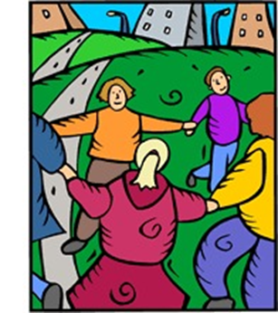
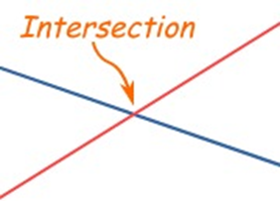
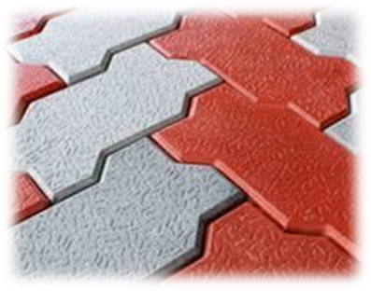
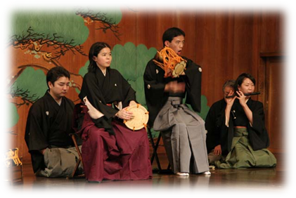
interact interval intersect
internet interlock interlude

Slide 46
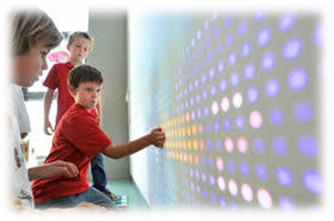
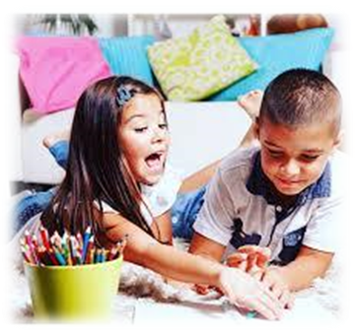
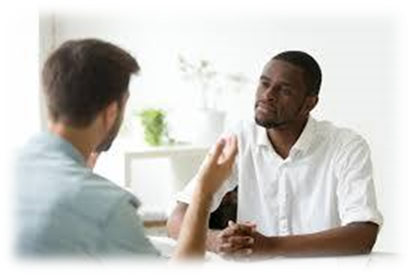
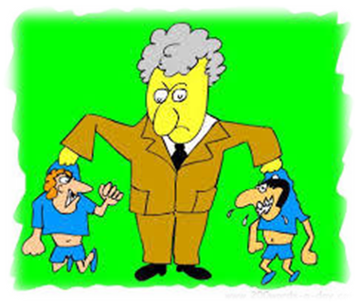
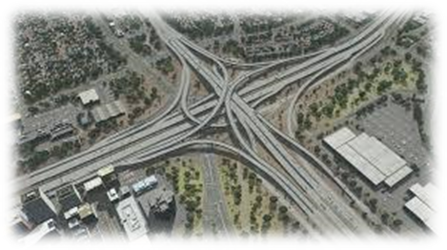
interactive interview interject
intervene interpreter interchange

Slide 47
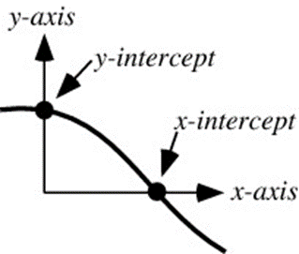
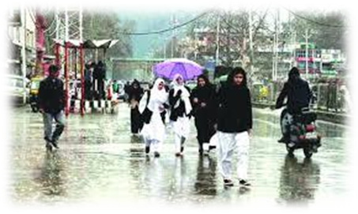
interloper interfere intercept
interweave intermittent international

Slide 48
“What do you think about international affairs between two countries?”

Slide 49
“What do you think about international affairs between two countries?”
I asked what he thought about international affairs between two countries.

Slide 50
parsing

Slide 51
They interviewed a new Spanish interpreter on Wednesday.

Slide 52
They interviewed a new Spanish interpreter on Wednesday.

Slide 53
They interviewed a new Spanish interpreter on Wednesday.

Slide 54
They interviewed a new Spanish interpreter on Wednesday.

Slide 55
They interviewed a new Spanish interpreter on Wednesday.

Slide 56
They interviewed a new Spanish interpreter on Wednesday.

Slide 57
They interviewed a new Spanish interpreter on Wednesday.

Slide 58
They interviewed a new Spanish interpreter on Wednesday.

Slide 59
They interviewed a new Spanish interpreter on Wednesday.
3rd person plural
Simple past

Slide 60
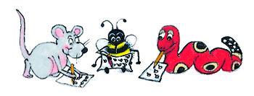
Dictation

Slide 61
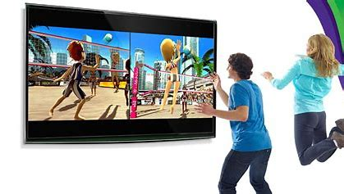
There are many interactive games on the internet.

Slide 62
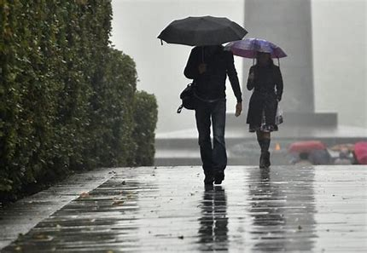
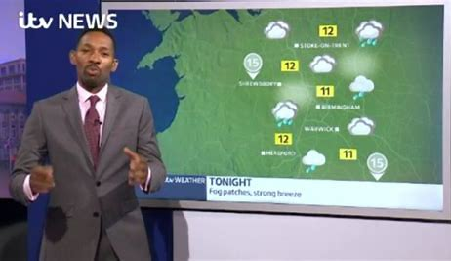
“The rain will be intermittent,” said the weatherman.

Slide 63
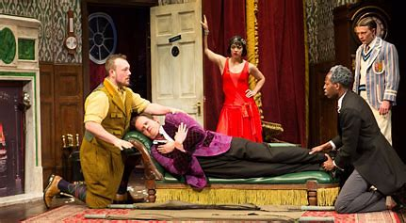
“Will the play have an interval?” asked the parents.

Slide 64
Thank you.
See you
next time!

