Slide 1
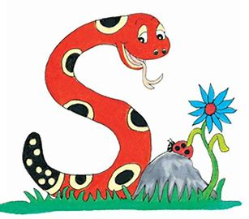
Jolly Grammar
4-34

Slide 2
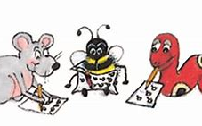
Spelling Test 33

Slide 3
anti-war

Slide 4
anti-war
anti-hero

Slide 5
anti-war
anti-hero
antibody

Slide 6
anti-war
anti-hero
antibody
antidote

Slide 7
anti-war
anti-hero
antibody
antidote
antiseptic

Slide 8
anti-war
anti-hero
antibody
antidote
antiseptic
antimatter

Slide 9
anti-war
anti-hero
antibody
antidote
antiseptic
antimatter
7.antifreeze

Slide 10
anti-war
anti-hero
antibody
antidote
antiseptic
antimatter
7.antifreeze
8.antisocial

Slide 11
anti-war
anti-hero
antibody
antidote
antiseptic
antimatter
7.antifreeze
8.antisocial
9.antipathy

Slide 12
anti-war
anti-hero
antibody
antidote
antiseptic
antimatter
7.antifreeze
8.antisocial
9.antipathy
10.anticlimax

Slide 13
anti-war
anti-hero
antibody
antidote
antiseptic
antimatter
7.antifreeze
8.antisocial
9.antipathy
10.anticlimax
11.anticyclone

Slide 14
anti-war
anti-hero
antibody
antidote
antiseptic
antimatter
7.antifreeze
8.antisocial
9.antipathy
10.anticlimax
11.anticyclone
12.anti-aircraft

Slide 15
anti-war
anti-hero
antibody
antidote
antiseptic
antimatter
7.antifreeze
8.antisocial
9.antipathy
10.anticlimax
11.anticyclone
12.anti-aircraft
13.anti-dandruff

Slide 16
anti-war
anti-hero
antibody
antidote
antiseptic
antimatter
7.antifreeze
8.antisocial
9.antipathy
10.anticlimax
11.anticyclone
12.anti-aircraft
13.anti-dandruff
14.antibiotic

Slide 17
anti-war
anti-hero
antibody
antidote
antiseptic
antimatter
7.antifreeze
8.antisocial
9.antipathy
10.anticlimax
11.anticyclone
12.anti-aircraft
13.anti-dandruff
14.antibiotic
15.antithesis

Slide 18
anti-war
anti-hero
antibody
antidote
antiseptic
antimatter
7.antifreeze
8.antisocial
9.antipathy
10.anticlimax
11.anticyclone
12.anti-aircraft
13.anti-dandruff
14.antibiotic
15.antithesis
16.antioxidant

Slide 19
anti-war
anti-hero
antibody
antidote
antiseptic
antimatter
7.antifreeze
8.antisocial
9.antipathy
10.anticlimax
11.anticyclone
12.anti-aircraft
13.anti-dandruff
14.antibiotic
15.antithesis
16.antioxidant
17.antibacterial

Slide 20
anti-war
anti-hero
antibody
antidote
antiseptic
antimatter
7.antifreeze
8.antisocial
9.antipathy
10.anticlimax
11.anticyclone
12.anti-aircraft
13.anti-dandruff
14.antibiotic
15.antithesis
16.antioxidant
17.antibacterial
18.anti-perspirant

Slide 21
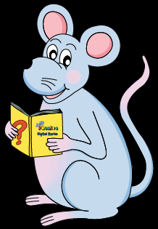
Let’s review
Infinitive.

Slide 22
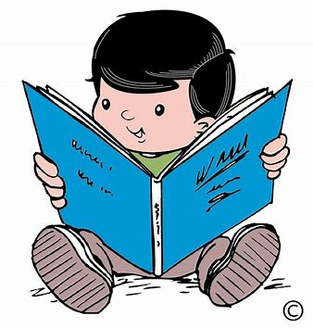
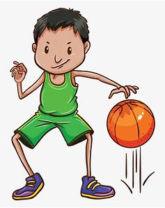
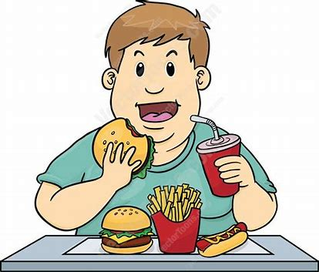

Slide 23
to eat

Slide 24
to eat to read

Slide 25
to eat to read to hike

Slide 26
to eat to read to hike to bounce

Slide 27
Let’s review
Synonyms and Antonyms.

Slide 28
Synonyms
big large
tell speak
cold cool

Slide 29
Synonyms ⇔ Antonyms
big large
tell speak
cold cool

Slide 30
Synonyms ⇔ Antonyms
big large
tell speak
cold cool
sad
dark
up
good
untidy
powerful

Slide 31
Synonyms ⇔ Antonyms
sad
dark
up
good
untidy
powerful
happy

Slide 32
Synonyms ⇔ Antonyms
sad
dark
up
good
untidy
powerful
happy
light

Slide 33
Synonyms ⇔ Antonyms
sad
dark
up
good
untidy
powerful
happy
light
down

Slide 34
Synonyms ⇔ Antonyms
sad
dark
up
good
untidy
powerful
happy
light
down
bad

Slide 35
Synonyms ⇔ Antonyms
sad
dark
up
good
untidy
powerful
happy
light
down
bad
tidy

Slide 36
Synonyms ⇔ Antonyms
sad
dark
up
good
untidy
powerful
happy
light
down
bad
tidy
powerless

Slide 37
Synonyms or Antonyms ?
achieve succeed synonyms
entrance exit
maximum minimum
avoid miss

Slide 38
Synonyms or Antonyms ?
achieve succeed synonyms
entrance exit antonyms
maximum minimum
avoid miss

Slide 39
Synonyms or Antonyms ?
achieve succeed synonyms
entrance exit antonyms
maximum minimum antonyms
avoid miss

Slide 40
Synonyms or Antonyms ?
achieve succeed synonyms
entrance exit antonyms
maximum minimum antonyms
avoid miss synonyms

Slide 41
Activity Page:
Antonyms and Synonyms

Slide 42
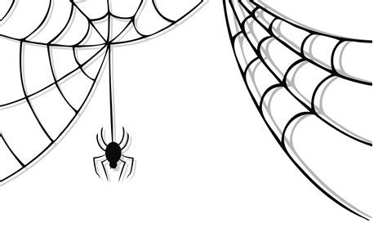
Read each set of words and cross out any that are not synonyms of the word in the spider’s web.
even
feathery
level
smooth

Slide 43
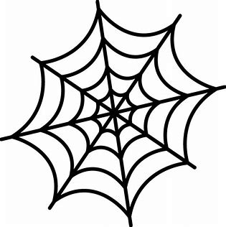
untrue
wrong
dense
false

Slide 44
medium
maximum
ordinary
average

Slide 45
difficult
unlike
changed
different

Slide 46
arched
rounded
pinched
curved

Slide 47
familiar
modest
shy
bashful

Slide 48
Write an antonym for each of the main words in the mirrors.
smooth
false
average
different
curved
bashful

Slide 49
Write an antonym for each of the main words in the mirrors.
smooth
rough
false
average
different
curved
bashful

Slide 50
Write an antonym for each of the main words in the mirrors.
smooth
rough
false
true
average
different
curved
bashful

Slide 51
Write an antonym for each of the main words in the mirrors.
smooth
rough
false
true
average
unusual
different
curved
bashful

Slide 52
Write an antonym for each of the main words in the mirrors.
smooth
rough
false
true
average
unusual
different
similar
curved
bashful

Slide 53
Write an antonym for each of the main words in the mirrors.
smooth
rough
false
true
average
unusual
different
similar
curved
straight
bashful

Slide 54
Write an antonym for each of the main words in the mirrors.
smooth
rough
false
true
average
unusual
different
similar
curved
straight
bashful
confident

Slide 55
Think of two synonyms and an antonym for each of these words, or use a thesaurus to help you.
interesting
comfortable
abominable
handsome
immense
bizarre

Slide 56
Think of two synonyms and an antonym for each of these words, or use a thesaurus to help you.
interesting
exciting
gripping
boring
comfortable
cozy
relaxed
uneasy
abominable
awful
dreadful
wonderful
handsome
attractive
charming
ugly
immense
huge
vast
tiny
bizarre
strange
odd
normal

Slide 57
Activity Page
Spelling <anti->

Slide 58
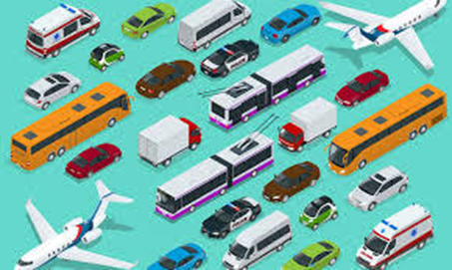
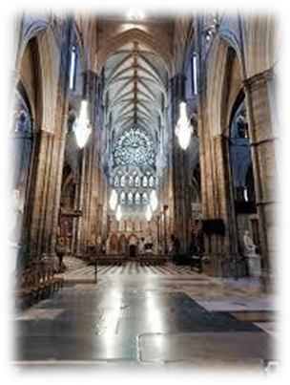
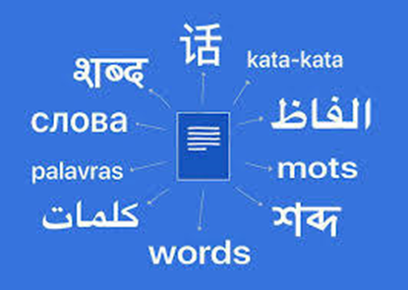
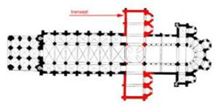
transport transfer transmit
transept transit translate

Slide 59
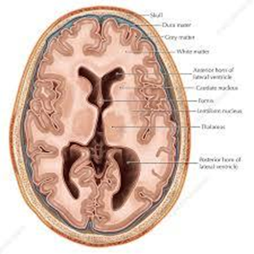
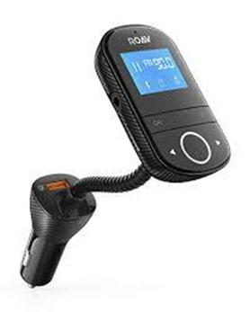
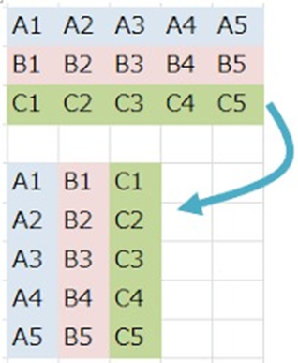
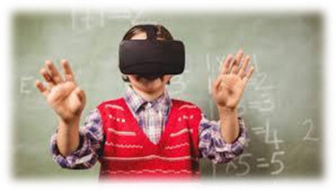
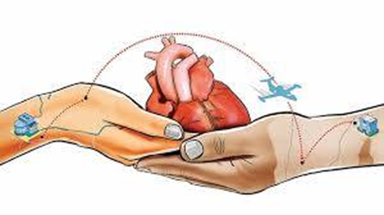
transpose transverse transmitter
transcend transplant transaction

Slide 60
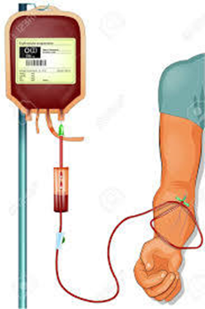
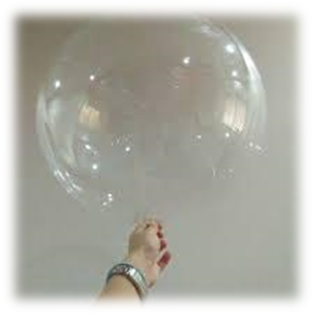
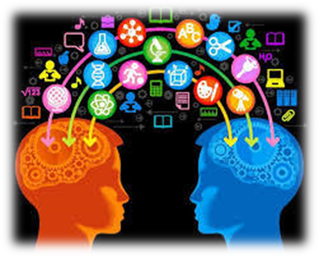
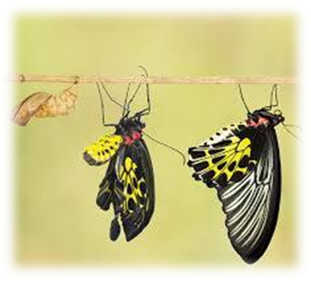
transitory transfusion transparent
translation transferable transformation

Slide 61
parsing

Slide 62
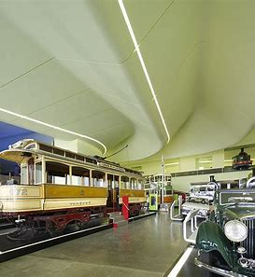
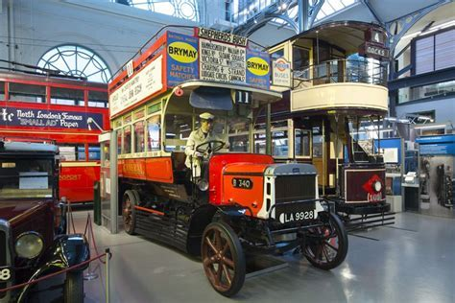
The transport museum will be undergoing a dramatic transformation.

Slide 63
The transport museum will be undergoing dramatic transformation.

Slide 64
The transport museum will be undergoing dramatic transformation.

Slide 65
The transport museum will be undergoing dramatic transformation.

Slide 66
The transport museum will be undergoing dramatic transformation.

Slide 67
The transport museum will be undergoing dramatic transformation.

Slide 68
The transport museum will be undergoing dramatic transformation.
3rd person singular
Future continuous

Slide 69
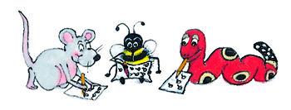
Dictation

Slide 70
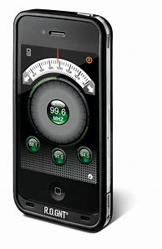
He twisted the dial on the radio transmitter.

Slide 71
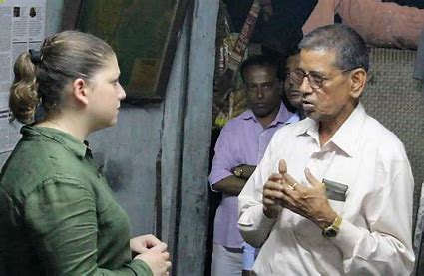
“A linguist will translate for me,” said the journalist.

Slide 72
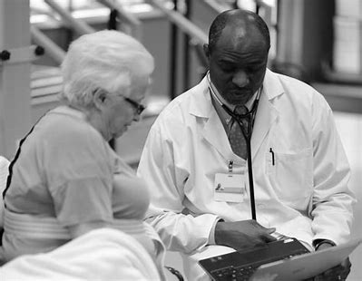
He was transferred to another ward in the hospital.

Slide 73
Thank you.
See you
next time!

