Slide 1
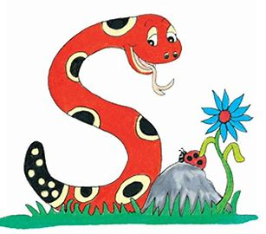
Jolly Grammar
4-31

Slide 2
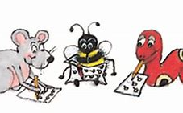
Spelling Test 30

Slide 3
exit

Slide 4
exit
resist

Slide 5
exit
resist
twist

Slide 6
exit
resist
twist
insist

Slide 7
exit
resist
twist
insist
artist

Slide 8
exit
resist
twist
insist
artist
consist

Slide 9
exit
resist
twist
insist
artist
consist
7.chemist

Slide 10
exit
resist
twist
insist
artist
consist
7.chemist
8.cyclist

Slide 11
exit
resist
twist
insist
artist
consist
7.chemist
8.cyclist
9.florist

Slide 12
exit
resist
twist
insist
artist
consist
7.chemist
8.cyclist
9.florist
10.persist

Slide 13
exit
resist
twist
insist
artist
consist
7.chemist
8.cyclist
9.florist
10.persist
11.soloist

Slide 14
exit
resist
twist
insist
artist
consist
7.chemist
8.cyclist
9.florist
10.persist
11.soloist
12.specialist

Slide 15
exit
resist
twist
insist
artist
consist
7.chemist
8.cyclist
9.florist
10.persist
11.soloist
12.specialist
13.guitarist

Slide 16
exit
resist
twist
insist
artist
consist
7.chemist
8.cyclist
9.florist
10.persist
11.soloist
12.specialist
13.guitarist
14.scientist

Slide 17
exit
resist
twist
insist
artist
consist
7.chemist
8.cyclist
9.florist
10.persist
11.soloist
12.specialist
13.guitarist
14.scientist
15.linguist

Slide 18
exit
resist
twist
insist
artist
consist
7.chemist
8.cyclist
9.florist
10.persist
11.soloist
12.specialist
13.guitarist
14.scientist
15.linguist
16.tourist

Slide 19
exit
resist
twist
insist
artist
consist
7.chemist
8.cyclist
9.florist
10.persist
11.soloist
12.specialist
13.guitarist
14.scientist
15.linguist
16.tourist
17.journalist

Slide 20
exit
resist
twist
insist
artist
consist
7.chemist
8.cyclist
9.florist
10.persist
11.soloist
12.specialist
13.guitarist
14.scientist
15.linguist
16.tourist
17.journalist
18.therapist

Slide 21
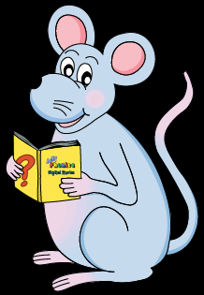
Let’s Review
Prefixes.

Slide 22
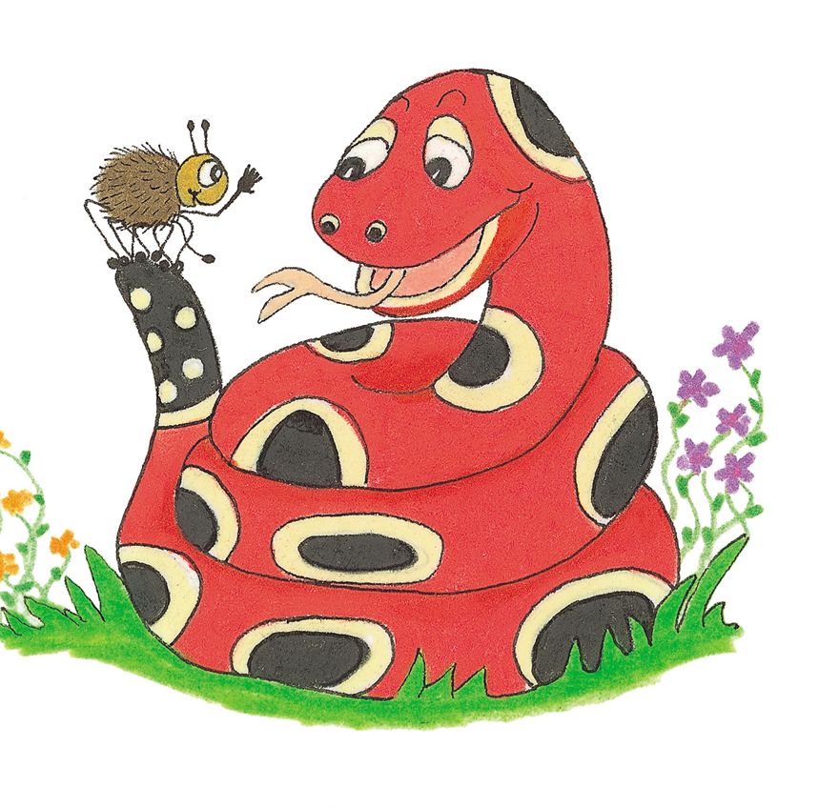
un | de | dis | mis | semi
unhappy unlucky undo unlock | decode decline | disappear disagree | misbehave mistake misunderstand | semifinal semicircle
im | non | re | mid | Good job!
impatient impossible immature | nonsense nonstop | rediscover refill | midnight midday

Slide 23
recycle

Slide 24
Let’s revise
Tenses.

Slide 25
I prepare dinner.
I shall be preparing dinner.
I prepared dinner.
He was walking the dog.
He will walk the dog.
He is walking the dog.

Slide 26
I prepare dinner. Simple present
I shall be preparing dinner.
I prepared dinner.
He was walking the dog.
He will walk the dog.
He is walking the dog.

Slide 27
I prepare dinner. Simple present
I shall be preparing dinner. Future continuous
I prepared dinner.
He was walking the dog.
He will walk the dog.
He is walking the dog.

Slide 28
I prepare dinner. Simple present
I shall be preparing dinner. Future continuous
I prepared dinner. Simple past
He was walking the dog.
He will walk the dog.
He is walking the dog.

Slide 29
I prepare dinner. Simple present
I shall be preparing dinner. Future continuous
I prepared dinner. Simple past
He was walking the dog. Past continuous
He will walk the dog.
He is walking the dog.

Slide 30
I prepare dinner. Simple present
I shall be preparing dinner. Future continuous
I prepared dinner. Simple past
He was walking the dog. Past continuous
He will walk the dog. Simple future
He is walking the dog.

Slide 31
I prepare dinner. Simple present
I shall be preparing dinner. Future continuous
I prepared dinner. Simple past
He was walking the dog. Past continuous
He will walk the dog. Simple future
He is walking the dog. Present continuous

Slide 32
Let’s learn
Infinitives.

Slide 33
Infinitives
to
to
to
to
cook
read
sing
dive
Jim decides to stay at home.

Slide 34
Infinitives
to
to
to
to
cook
read
sing
dive
Jim decides to stay at home.

Slide 35
Infinitives
to
to
to
to
cook
read
sing
dive
s
Jim decides to stay at home.

Slide 36
Activity Page
Grammar:
Infinitives

Slide 37
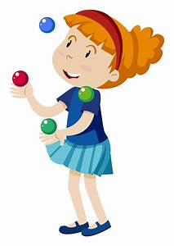
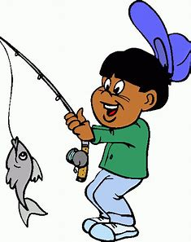
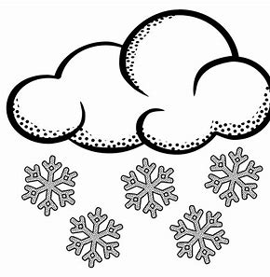
to fish to explode to snow to jungle

Slide 38
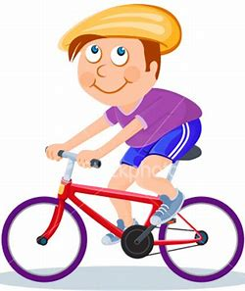
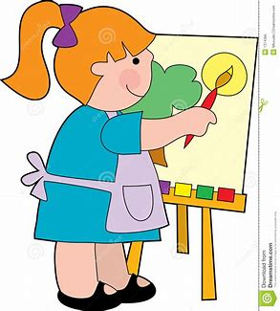
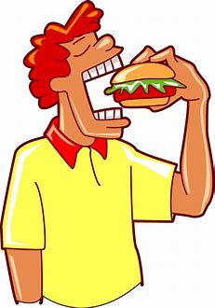
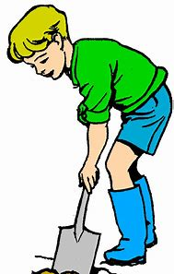
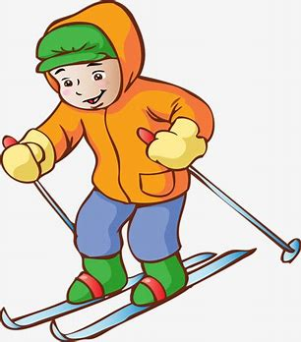
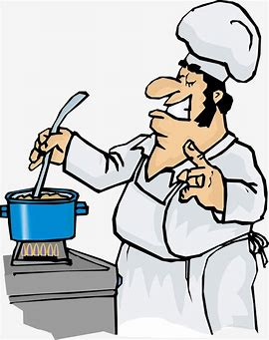
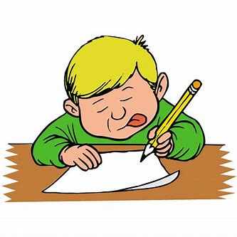
to cycle to paint to read to eat
to dig to write to ski to cook

Slide 39
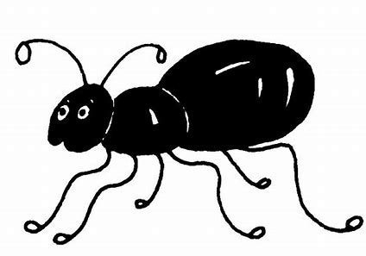
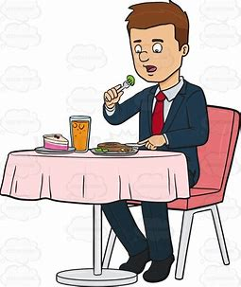
Identify the infinitive in each sentence and underline it in pencil. Then find the main verb and underline it in red. Put a box with a small <s> in the corner around the subject.
s
He preferred to eat at the new restaurant.

Slide 40
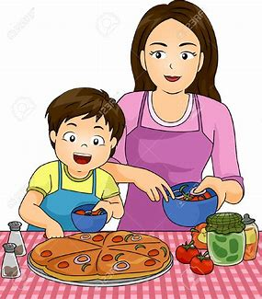
I will be helping to cook the dinner.

Slide 41
s
I will be helping to cook the dinner.

Slide 42
She demanded to speak to the manager.

Slide 43
s
She demanded to speak to the manager.

Slide 44
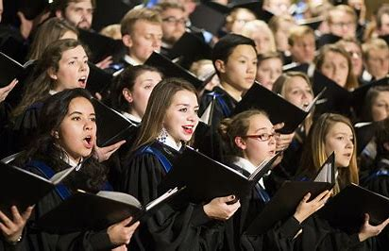
The student yearned to sing in the choir.

Slide 45
s
The student yearned to sing in the choir.

Slide 46
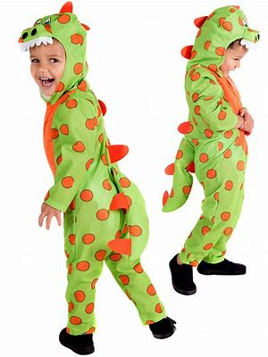
The children pretended to be dinosaurs.

Slide 47
s
The children pretended to be dinosaurs.

Slide 48
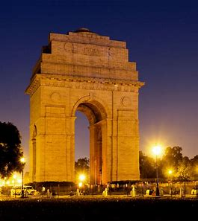
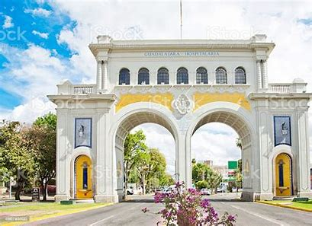
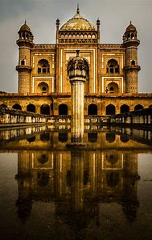
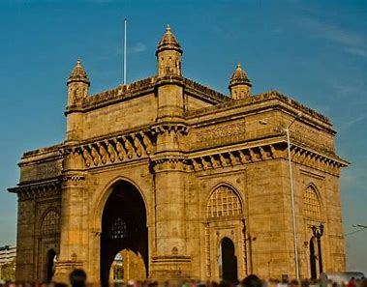
The tourist hoped to see many monuments.

Slide 49
s
The tourist hoped to see many monuments.

Slide 50
Activity Page
Spelling <pre->

Slide 51
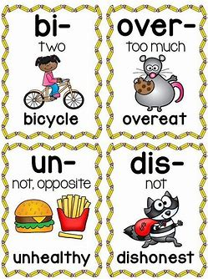
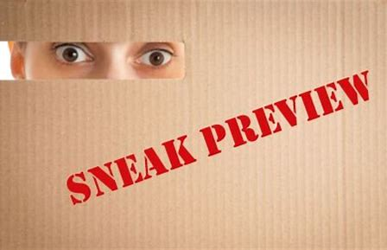
prepare prevent prefix
to make something ready, or to get ready for something
to stop something happening, or to stop someone doing something
A letter or some letters that are added at the beginning of a word to change its meaning.
prevail preview predict
to say that something will happen in the future

Slide 52
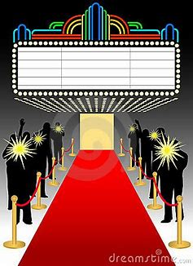
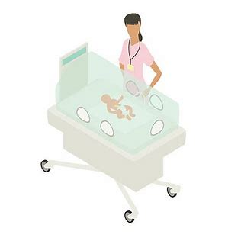
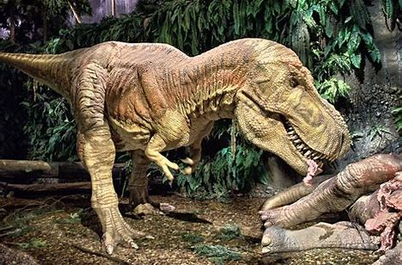
precede premiere precedent
prehistoric preference premature
From a very long time ago, before anything was written down

Slide 53
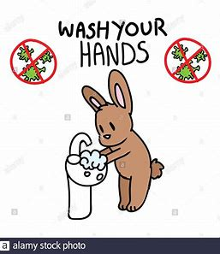
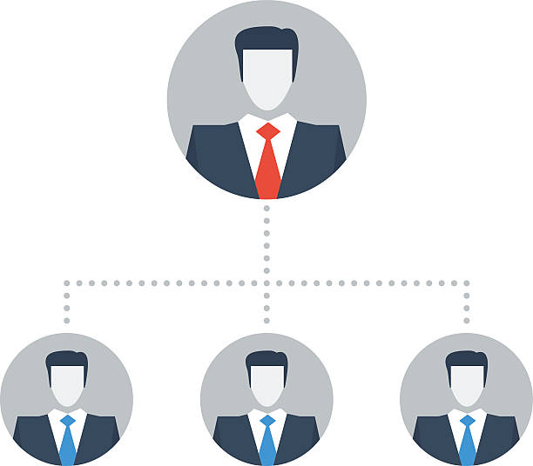
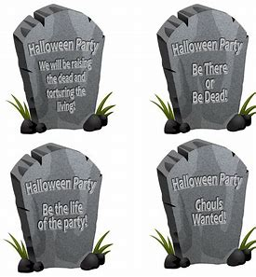
previously predecessor prearrange
Happening before something
preliminary presumption precautionary

Slide 54
Activity Page
Spelling:
<pre->

Slide 55
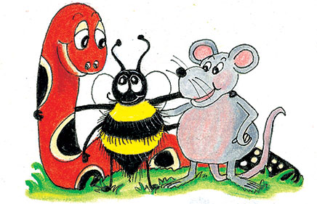
parsing

Slide 56
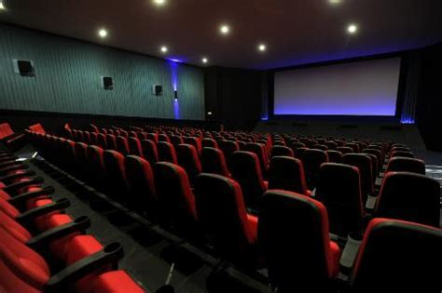
Delays were preventing the premiere of a controversial new play.

Slide 57
Delays were preventing the premiere of a controversial new play.

Slide 58
Delays were preventing the premiere of a controversial new play.

Slide 59
Delays were preventing the premiere of a controversial new play.

Slide 60
Delays were preventing the premiere of a controversial new play.

Slide 61
Delays were preventing the premiere of a controversial new play.

Slide 62
Delays were preventing the premiere of a controversial new play.

Slide 63
Delays were preventing the premiere of a controversial new play.

Slide 64
Delays were preventing the premiere of a controversial new play.
3rd person plural
Past continuous

Slide 65
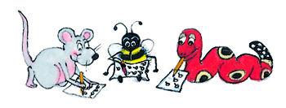
Dictation

Slide 66
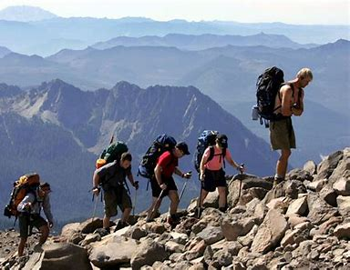
They prepared to ascend the majestic mountain.

Slide 67
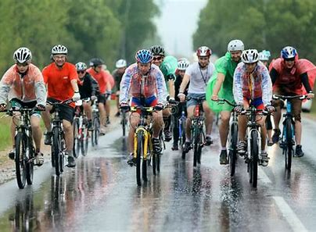
The cyclists had not predicted the abysmal weather.

Slide 68
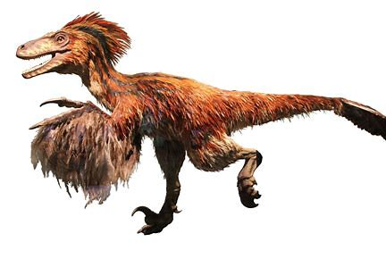
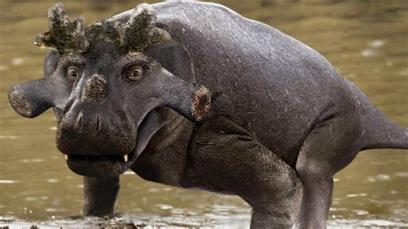
Prehistoric creatures preceded our modern animals.

Slide 69
Thank you.
See you
next time!

