Slide 1
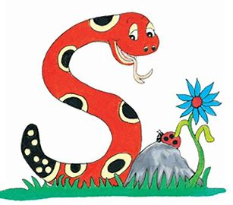
Jolly Grammar
4-32

Slide 2
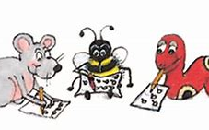
Spelling Test 31

Slide 3
prepare

Slide 4
prepare
prevent

Slide 5
prepare
prevent
prefix

Slide 6
prepare
prevent
prefix
prevail

Slide 7
prepare
prevent
prefix
prevail
preview

Slide 8
prepare
prevent
prefix
prevail
preview
predict

Slide 9
prepare
prevent
prefix
prevail
preview
predict
7.precede

Slide 10
prepare
prevent
prefix
prevail
preview
predict
7.precede
8.premiere

Slide 11
prepare
prevent
prefix
prevail
preview
predict
7.precede
8.premiere
9.precedent

Slide 12
prepare
prevent
prefix
prevail
preview
predict
7.precede
8.premiere
9.precedent
10.prehistoric

Slide 13
prepare
prevent
prefix
prevail
preview
predict
7.precede
8.premiere
9.precedent
10.prehistoric
11.preference

Slide 14
prepare
prevent
prefix
prevail
preview
predict
7.precede
8.premiere
9.precedent
10.prehistoric
11.preference
12.premature

Slide 15
prepare
prevent
prefix
prevail
preview
predict
7.precede
8.premiere
9.precedent
10.prehistoric
11.preference
12.premature
13.previously

Slide 16
prepare
prevent
prefix
prevail
preview
predict
7.precede
8.premiere
9.precedent
10.prehistoric
11.preference
12.premature
13.previously
14.predecessor

Slide 17
prepare
prevent
prefix
prevail
preview
predict
7.precede
8.premiere
9.precedent
10.prehistoric
11.preference
12.premature
13.previously
14.predecessor
15.prearrange

Slide 18
prepare
prevent
prefix
prevail
preview
predict
7.precede
8.premiere
9.precedent
10.prehistoric
11.preference
12.premature
13.previously
14.predecessor
15.prearrange
16.preliminary

Slide 19
prepare
prevent
prefix
prevail
preview
predict
7.precede
8.premiere
9.precedent
10.prehistoric
11.preference
12.premature
13.previously
14.predecessor
15.prearrange
16.preliminary
17.presumption

Slide 20
prepare
prevent
prefix
prevail
preview
predict
7.precede
8.premiere
9.precedent
10.prehistoric
11.preference
12.premature
13.previously
14.predecessor
15.prearrange
16.preliminary
17.presumption
18.precautionary

Slide 21
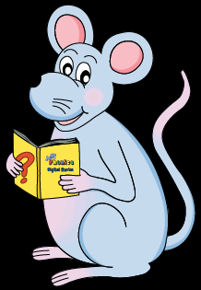
Let’s learn
Onomatopoeia.

Slide 22
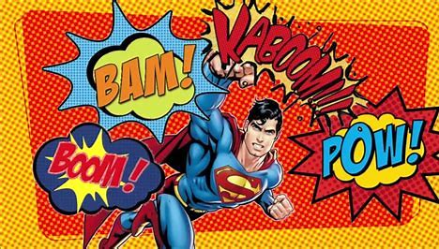

Slide 23
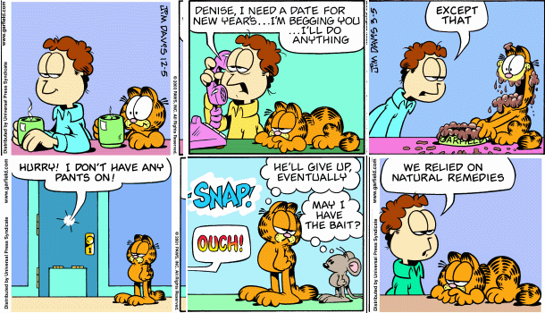

Slide 24
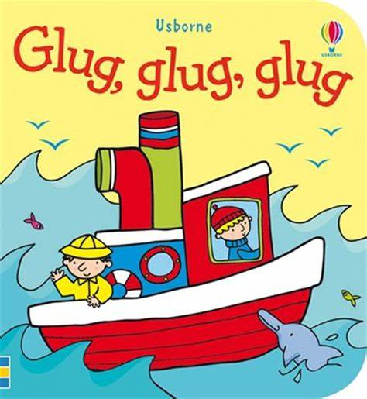
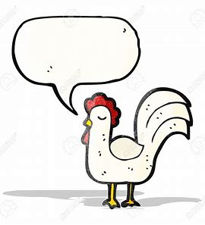
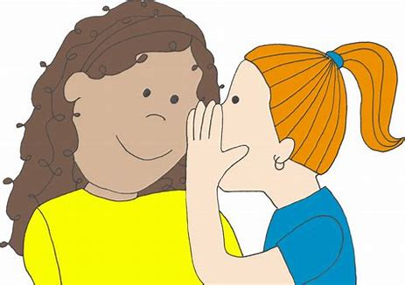
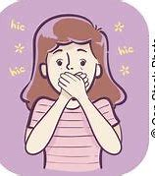
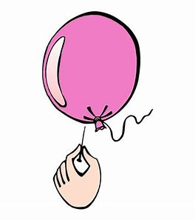
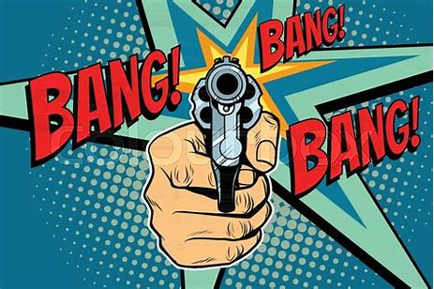
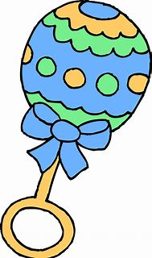
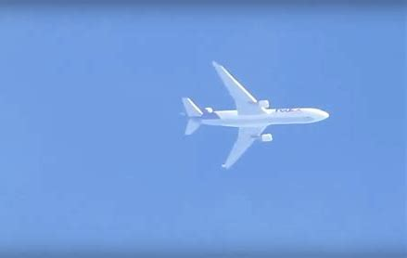
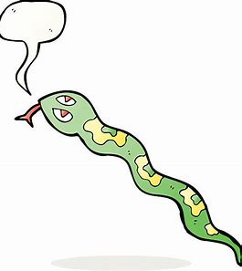
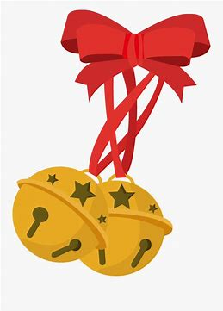
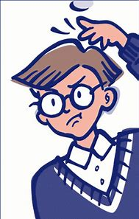
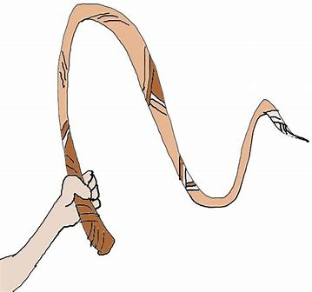
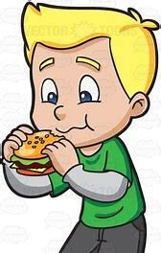
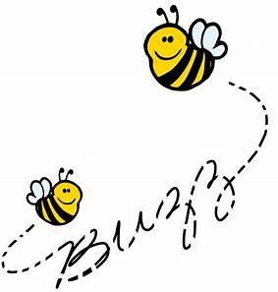
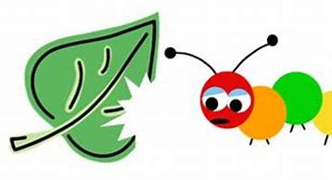
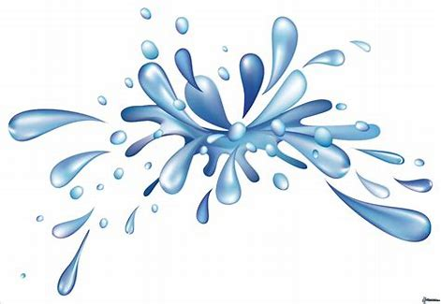
whisper
pop
zoom
buzz
scratch
glug
click
jingle
crunch
hiccup
rattle
munch
flutter
cluck
bang
hiss
swish
splash

Slide 25
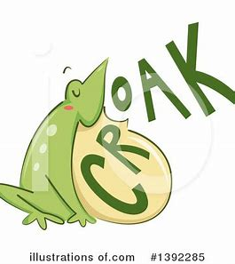
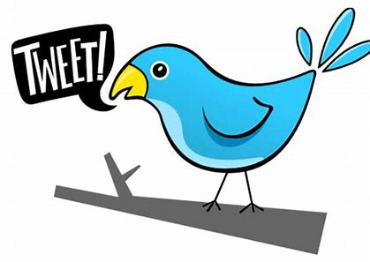
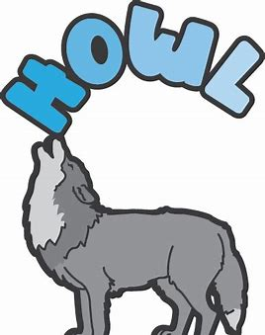
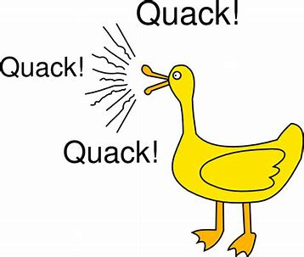
What are these animals saying? Write a suitable onomatopoeic word in each speech bubble.

Slide 26
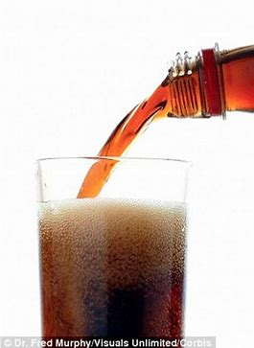
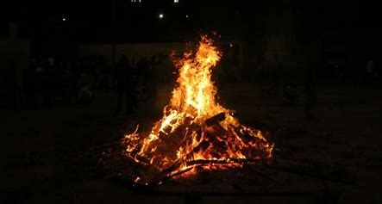
Think of an onomatopoeic word for each of the picture below.

Slide 27
Think of an onomatopoeic word for each of the picture below.
clap
crackle
fizz

Slide 28
Draw pictures for those onomatopoeic words.
smash
sizzle
squeak

Slide 29
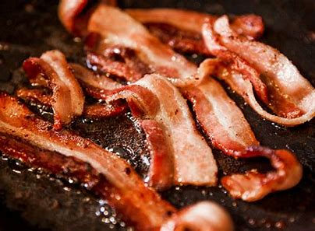
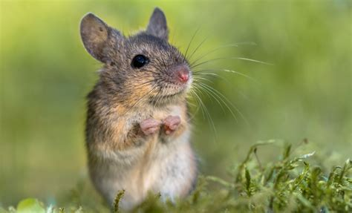
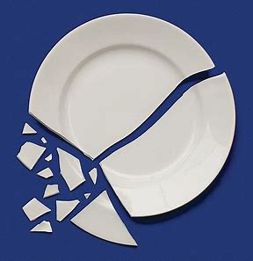
Draw pictures for those onomatopoeic words.
smash
sizzle
squeak

Slide 30
Match each noun phrase to its onomatopoeic word.
a happy cat
a van stopping quicky
a small bell
someone drinking noisily
a car’s horn
a heavy box hitting the ground

Slide 31
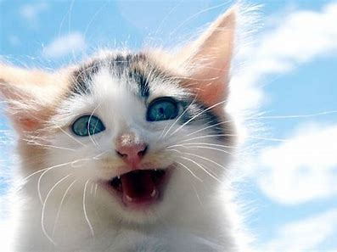
Match each noun phrase to its onomatopoeic word.
a happy cat purr
a van stopping quicky
a small bell
someone drinking noisily
a car’s horn
a heavy box hitting the ground

Slide 32
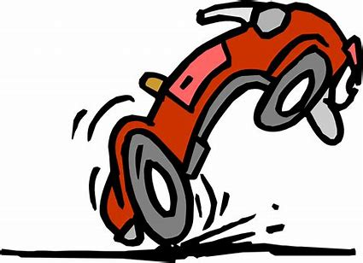
Match each noun phrase to its onomatopoeic word.
a happy cat purr
a van stopping quicky screech
a small bell
someone drinking noisily
a car’s horn
a heavy box hitting the ground

Slide 33
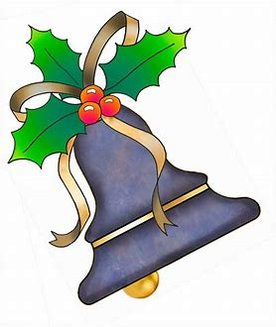
Match each noun phrase to its onomatopoeic word.
a happy cat purr
a van stopping quicky screech
a small bell twinkle
someone drinking noisily
a car’s horn
a heavy box hitting the ground

Slide 34
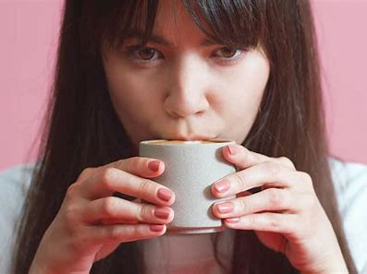
Match each noun phrase to its onomatopoeic word.
a happy cat purr
a van stopping quicky screech
a small bell twinkle
someone drinking noisily slurp
a car’s horn
a heavy box hitting the ground

Slide 35
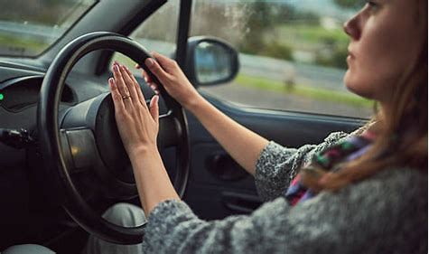
Match each noun phrase to its onomatopoeic word.
a happy cat purr
a van stopping quicky screech
a small bell twinkle
someone drinking noisily slurp
a car’s horn honk
a heavy box hitting the ground

Slide 36
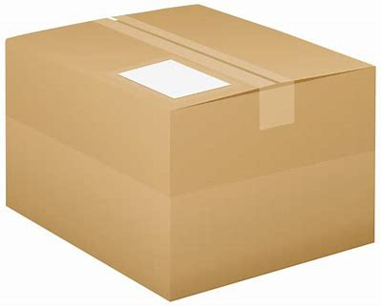
Match each noun phrase to its onomatopoeic word.
a happy cat purr
a van stopping quicky screech
a small bell twinkle
someone drinking noisily slurp
a car’s horn honk
a heavy box hitting the ground thud

Slide 37
Activity Page
Spelling <sub->

Slide 38
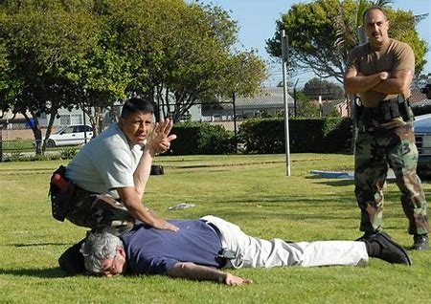
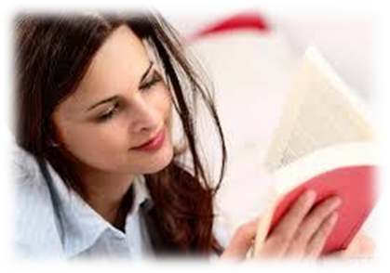
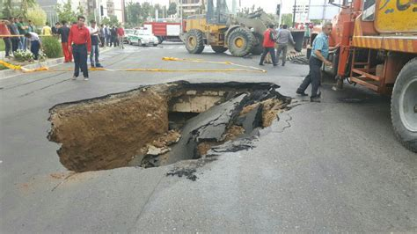
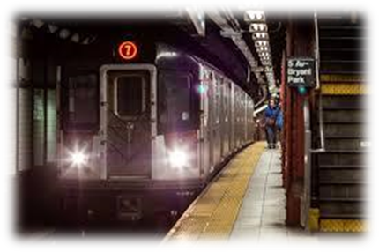
submit subdue subplot
To present for the approval or consideration
To overpower by superior force
A secondary plot as in literary work
subside subvert subway
to sink to a low or lower level
To cause the downfall, ruin of
A tunnel under a street for people to walk through

Slide 39
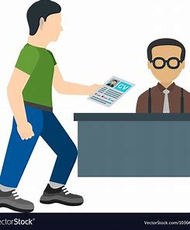
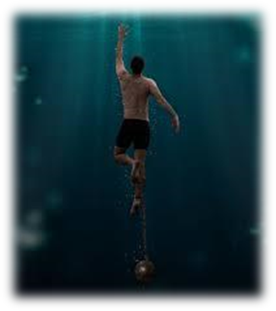
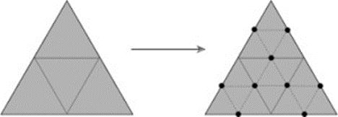
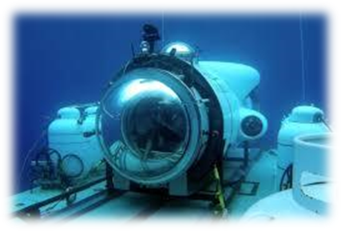
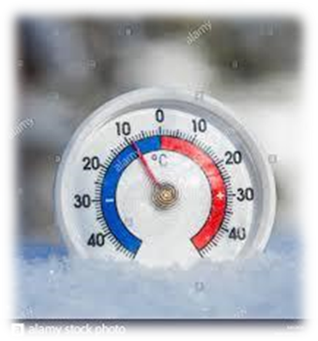
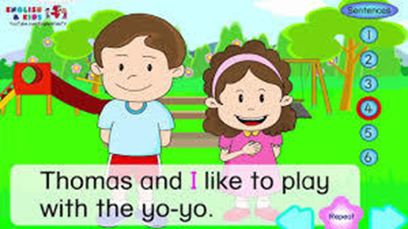
subdivide submission submerge
to divide into smaller parts
The act of submitting
To put or sink below the surface of water
subtitle sub-zero submersible
The text of dialogue, speeches
Indicating lower than zero
Capable of being under water

Slide 40
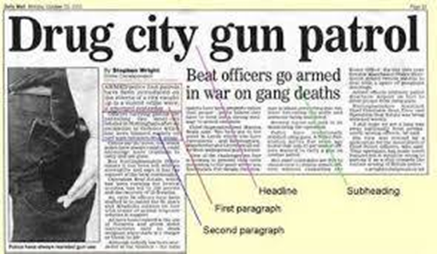
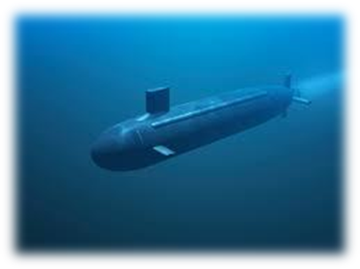
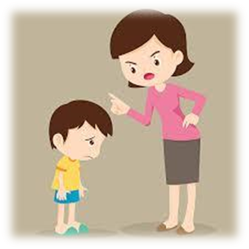
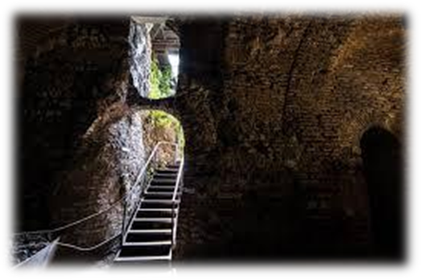
subheading subordinate submarine
The heading or title of a subdivision or a printed work
Placed in or belonging to a lower order or rank
A kind of ship that travels under the sea
submissive subconscious subterranean
Ready to submit to the authority
existing in the mind beneath consciousness
Existing below surface of the eath

Slide 41
Check what this word means and see how many other words you can make using its letters.
s u b t e r r a n e a n

Slide 42
Check what this word means and see how many other words you can make using its letters.
s u b t e r r a n e a n
art
butter
ten
tent

Slide 43
parsing

Slide 44
The earth from the subsidence is blocking the subterranean tunnels.

Slide 45
The earth from the subsidence is blocking the subterranean tunnels.

Slide 46
The earth from the subsidence is blocking the subterranean tunnels.

Slide 47
The earth from the subsidence is blocking the subterranean tunnels.

Slide 48
The earth from the subsidence is blocking the subterranean tunnels.

Slide 49
The earth from the subsidence is blocking the subterranean tunnels.

Slide 50
The earth from the subsidence is blocking the subterranean tunnels.

Slide 51
The earth from the subsidence is blocking the subterranean tunnels.
3rd person singular
Present continuous

Slide 52
Dictation

Slide 53
Giant crystals exist in the subterranean cavern.

Slide 54
Tourists visited the wreck in a small submersible.

Slide 55
“The submarines were fantastic!” exclaimed Dad.

Slide 56
Thank you.
See you
next time!

