Slide 1
Jolly Grammar 2-28

Slide 2
Mini Test 27

Slide 3
kiln

Slide 4
kiln
wept

Slide 5
kiln
wept
hare

Slide 6
kiln
wept
hare
care

Slide 7
kiln
wept
hare
care
share

Slide 8
kiln
wept
hare
care
share
6. scare

Slide 9
kiln
wept
hare
care
share
6. scare
7. square

Slide 10
kiln
wept
hare
care
share
6. scare
7. square
8. nightmare

Slide 11
kiln
wept
hare
care
share
6. scare
7. square
8. nightmare
9. millilitre

Slide 12
kiln
wept
hare
care
share
6. scare
7. square
8. nightmare
9. millilitre
10. litre

Slide 13
Let’s review
Prefixes

Slide 14
Make new words by joining up the prefixes and base words below.
tele-
tri-
scope
angle
cycle
vision

Slide 15
Make new words by joining up the prefixes and base words below.
tele-
tri-
scope
angle
cycle
vision
telescope

Slide 16
Make new words by joining up the prefixes and base words below.
tele-
tri-
scope
angle
cycle
vision
telescope
triangle

Slide 17
Make new words by joining up the prefixes and base words below.
tele-
tri-
scope
angle
cycle
vision
telescope
triangle
tricycle

Slide 18
Make new words by joining up the prefixes and base words below.
tele-
tri-
scope
angle
cycle
vision
telescope
triangle
tricycle
television

Slide 19
Let’s review
punctuation

Slide 20
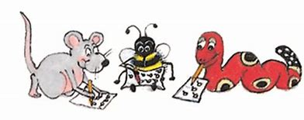
“Do you like vegetables?”
I asked my sister.
She said
“Yes. I love onions, spinach, eggplants and cabbage.”

Slide 21
Let’s learn
Apostrophe<s>

Slide 22
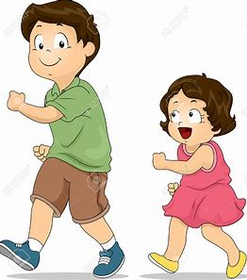
Kate’s bike
Luke’s sister

Slide 23
Ms. Yano’s computer
Mizuki’s pencil case
Leo’s bear
Mao’s mask
Ai’s jacket
Kenshi’s face
Yugen’s dictionary

Slide 24
Activity page1
Apostrophe<s>

Slide 25
Anna’s apple
Ben’s book
C
D
E
F
G
H
I
Anna

Slide 26
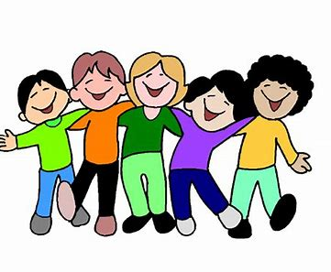
Anna
Ben
Christine
David
Eve
Frank
Greg
Helen
Isak
Jack
Katie
Laura
Mike
Nora
Olivia
Peter
Quentin
Rose
Sara
Tami
Usain
Valerie
William
Xander
Yolanda
Zoe

Slide 27
Sara’s
scooter
Tami’s
Taketombo
Usain’s umbrella
Valerie’s violin
William’s watch
Xander’s xylophone
Yolanda’s yoyo
Zoe’s zebra
Anna’s apple
Ben’s book
Christine’s cat
David’s
dictionary
Eve’s egg
Frank’s family
Greg’s gloves
Helen’s hands
Isak’s igloo
Jack’s
jellyfish
Katie’s
kangaroo
Laura’s lemon
Mike’s mic
Nora’s notebooks
Olivia’s olives
Peter’s pants
Quentin’s quilt
Rose’s
roller skates

Slide 28
Sara’s salad
Tami’s T-shirt
Usain’s umbrella
Valerie’s violin
William’s whale
Xander’s
xylophone
Yolanda’ yoyo
Zoe’s zebra
Anna’s apple
Ben’s book
Chris’s cat
David’s doll
Eve’s egg
Frank’s fish
Greg’s grapes
Helen’s hat
Isak’s
ice cream
Jack’s jacket
Katie’s kite
Laura’s lemon
Mike’s milk
Nora’s notes
Olivia’s olives
Peter’s pepper
Quentin’s quiz
Rose’s rose

Slide 29
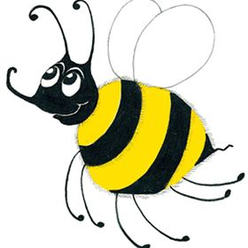
Measurement Words
centimetre cm
metre m
gram g
kilogram kg
millilitre ml
litre l
weight
volume
minute
second
fraction
estimate

Slide 30
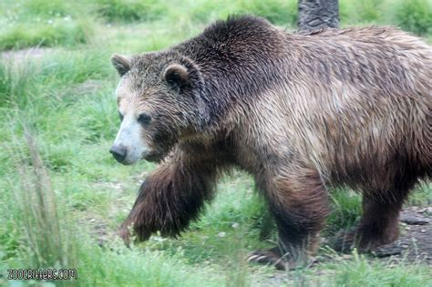
bear
/air/

Slide 31
Activity page2

Slide 32
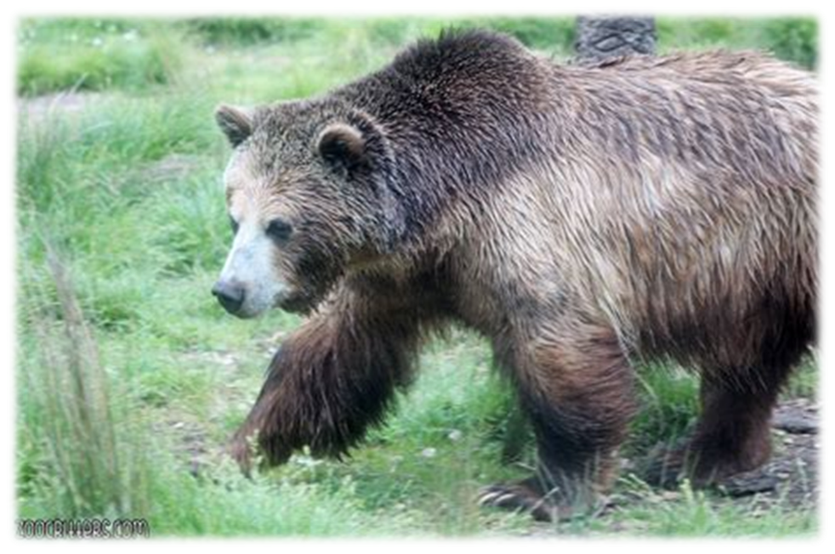
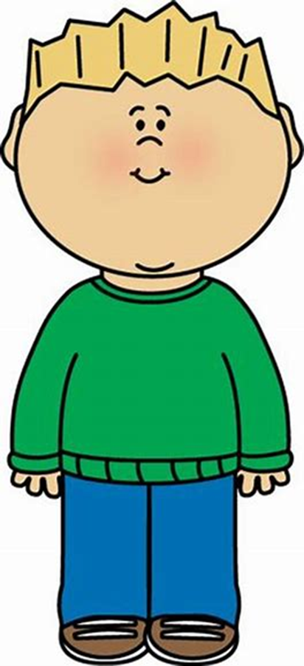
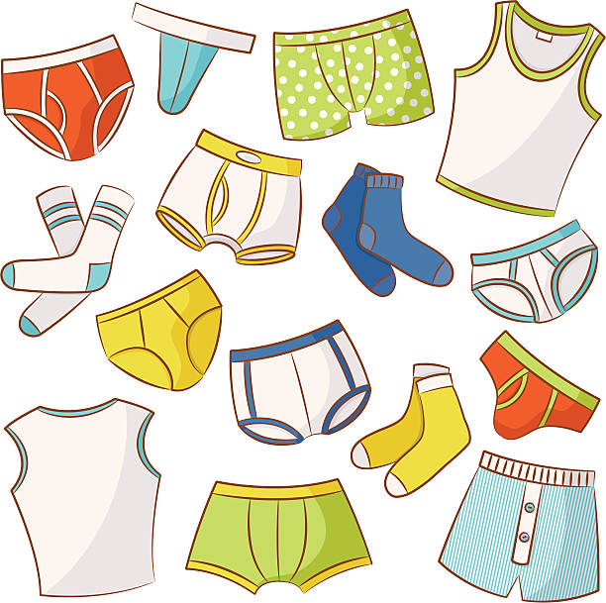
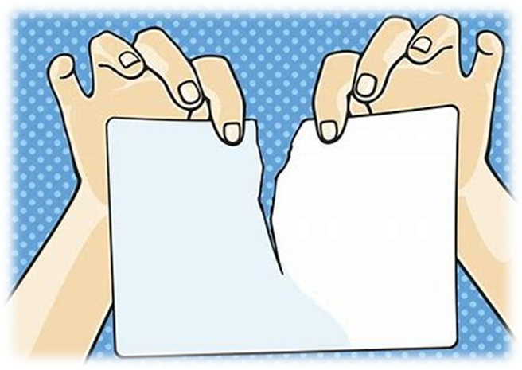
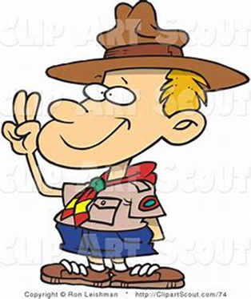
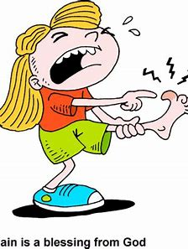
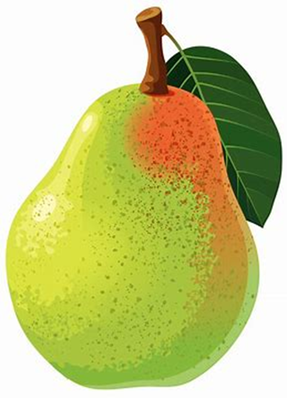
bear
wear
underwear
mend
silk
bear
tear
pear
wear
swear
underwear
weight
volume
tear
swear
bearing
pear

Slide 33
Dictation

Slide 34
wear

Slide 35
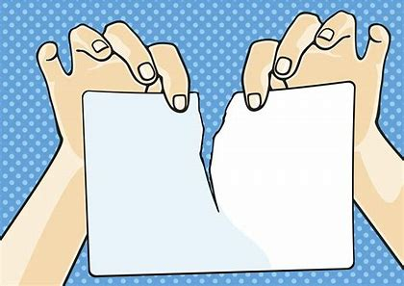
wear 2. tearing

Slide 36
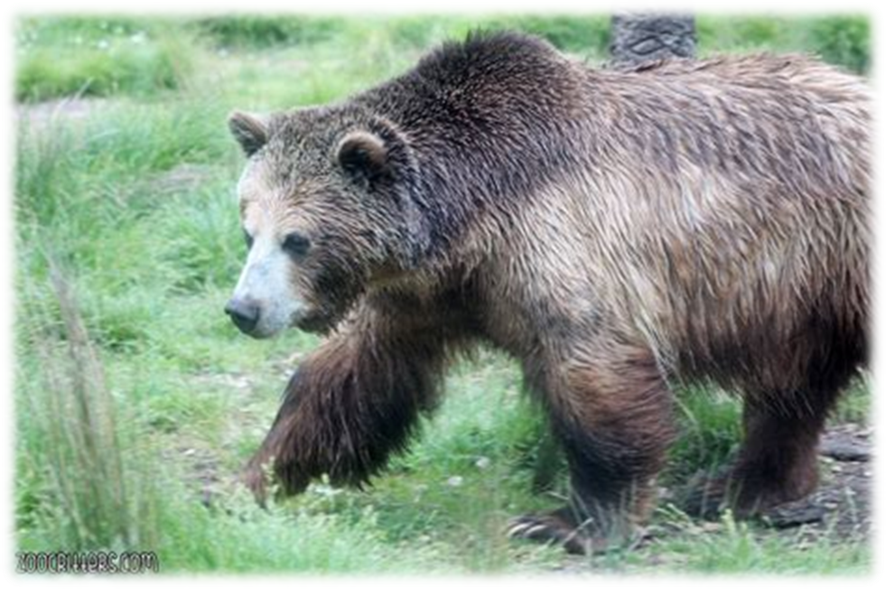
wear 2. tearing 3. bear

Slide 37
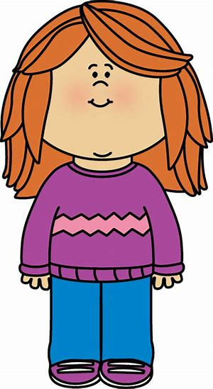
wear 2. tearing 3. bear
4. wearing

Slide 38
wear 2. tearing 3. bear
4. wearing 5. pear

Slide 39
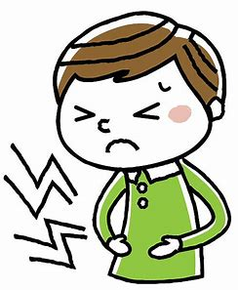
wear 2. tearing 3. bear
4. wearing 5. pear 6. bearing

Slide 40
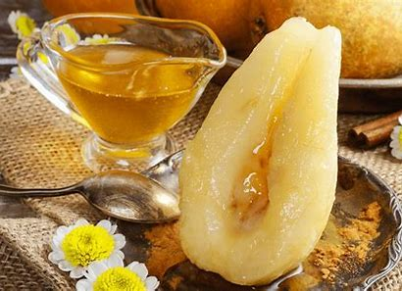
wear 2. tearing 3. bear
4. wearing 5. pear 6. bearing
7. She ate pears with honey.

Slide 41
wear 2. tearing 3. bear
4. wearing 5. pear 6. bearing
7. She ate pears with honey.
8. I cannot bear the way
he swears.

Slide 42
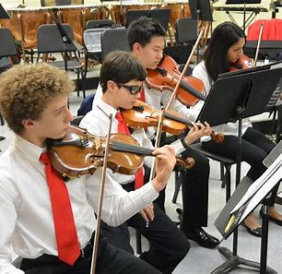
wear 2. tearing 3. bear
4. wearing 5. pear 6. bearing
7. She ate pears with honey.
8. I cannot bear the way
he swears.
9. The orchestra wears
orange.

Slide 43
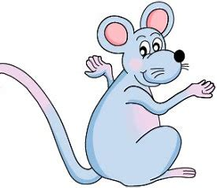
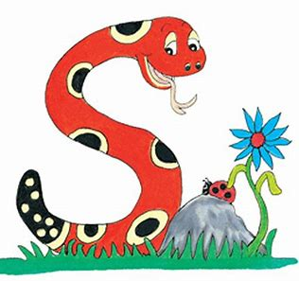
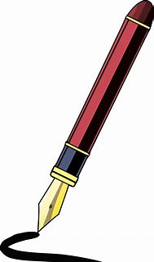
What are these things and whose are they?
There is an apostrophe <s> missing from each of these sentences. Write them in.
Bee went to Inky house on Saturday morning.
Inky liked Bee new red boots.

Slide 44
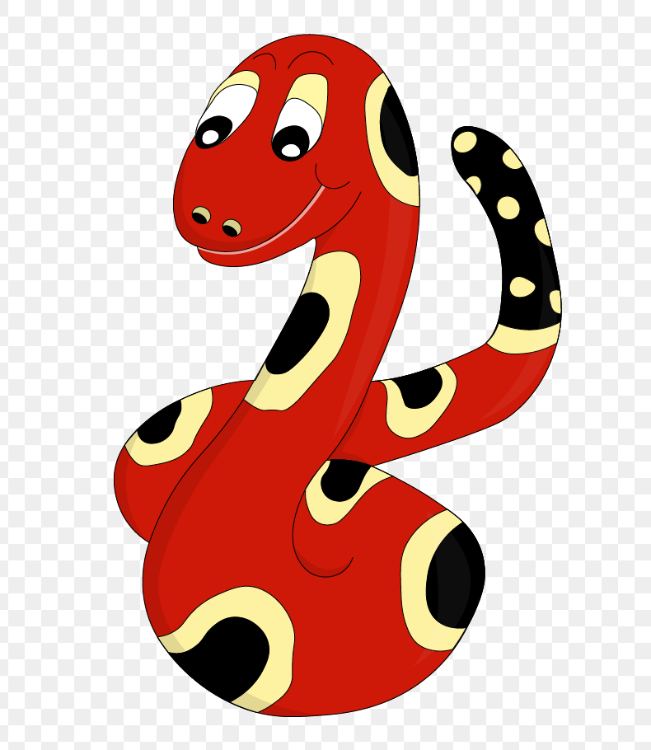
Thank you!
See you
next lesson.

