Slide 1
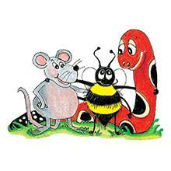
Jolly Grammar 2-31

Slide 2
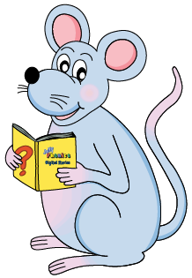
Mini Test 30

Slide 3
fist

Slide 4
fist
best

Slide 5
fist
best
occasion

Slide 6
fist
best
occasion
division

Slide 7
fist
best
occasion
division
revision

Slide 8
fist
best
occasion
division
revision
6. invasion

Slide 9
fist
best
occasion
division
revision
6. invasion
7. explosion

Slide 10
fist
best
occasion
division
revision
6. invasion
7. explosion
8. television

Slide 11
fist
best
occasion
division
revision
6. invasion
7. explosion
8. television
9. fraction

Slide 12
fist
best
occasion
division
revision
6. invasion
7. explosion
8. television
9. fraction
10. estimate

Slide 13
Let’s review
preposition

Slide 14
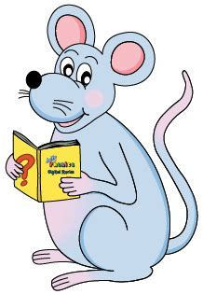
Complete each sentence with a preposition.
to from in beside up
I want to sit my best friend.
Kayla climbed the ladder.
We read left right.
Grandpa keeps his keys his pocket.

Slide 15
Complete each sentence with a preposition.
to from in beside up
I want to sit beside my best friend.
Kayla climbed the ladder.
We read left right.
Grandpa keeps his keys his pocket.

Slide 16
Complete each sentence with a preposition.
to from in beside up
I want to sit beside my best friend.
Kayla climbed up the ladder.
We read left right.
Grandpa keeps his keys his pocket.

Slide 17
Complete each sentence with a preposition.
to from in beside up
I want to sit beside my best friend.
Kayla climbed up the ladder.
We read from left right.
Grandpa keeps his keys his pocket.

Slide 18
Complete each sentence with a preposition.
to from in beside up
I want to sit beside my best friend.
Kayla climbed up the ladder.
We read from left to right.
Grandpa keeps his keys his pocket.

Slide 19
Complete each sentence with a preposition.
to from in beside up
I want to sit beside my best friend.
Kayla climbed up the ladder.
We read from left to right.
Grandpa keeps his keys in his pocket.

Slide 20
Activity page1
Finding the Meaning

Slide 21
Remember: Homophones sound the same but have different spellings and meanings.
Use a dictionary to find out which word has which meaning. Write the meaning of each word on the line beside it.
dear
deer

Slide 22
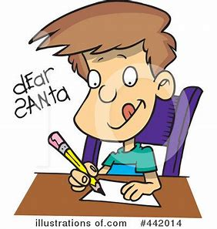
Remember: Homophones sound the same but have different spellings and meanings.
Use a dictionary to find out which word has which meaning. Write the meaning of each word on the line beside it.
A word you use about someone or something you love. A word used to start a letter
dear
deer

Slide 23
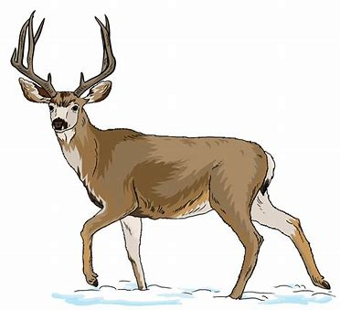
Remember: Homophones sound the same but have different spellings and meanings.
Use a dictionary to find out which word has which meaning. Write the meaning of each word on the line beside it.
A word you use about someone or something you love. A word used to start a letter
dear
deer
A big animal that eats grass and can fun fast. The male has big horns on its head like branches.

Slide 24
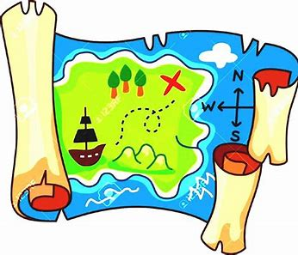
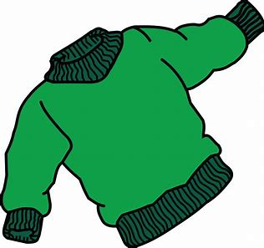
where or wear?
“ are we going?” asked Kelly.
I want to my favourite sweater.

Slide 25
where or wear?
“ Where are we going?” asked Kelly.
I want to my favourite sweater.

Slide 26
where or wear?
“ Where are we going?” asked Kelly.
I want to wear my favourite sweater.

Slide 27
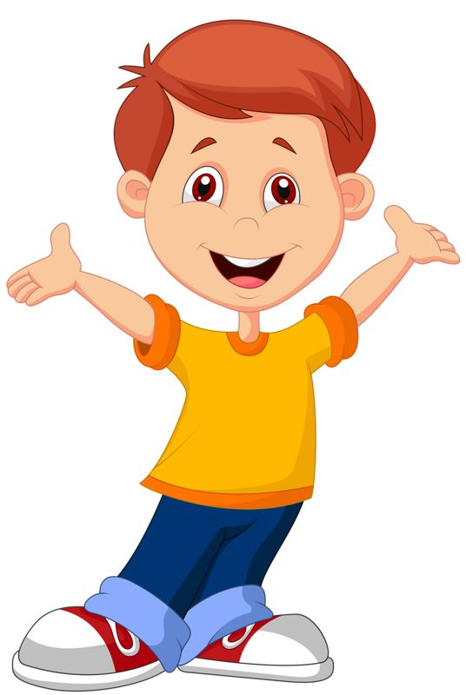
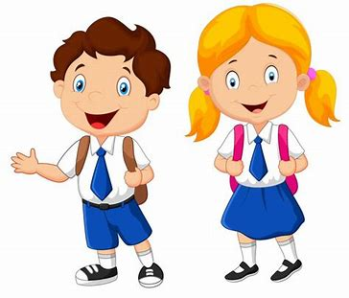
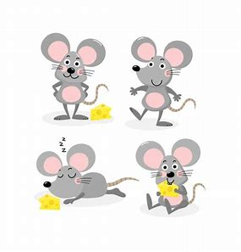
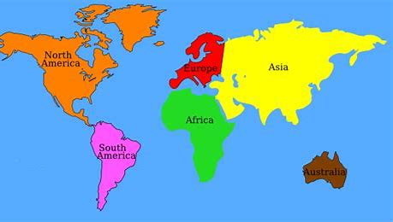
Tricky Plurals (and more)
child
children
woman
women
mouse
mice
library
computer
English
language
continent
world

Slide 28
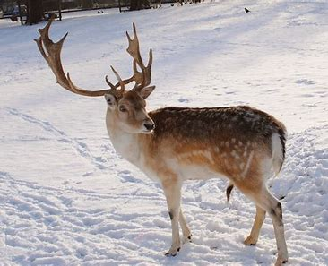
eight
/ai/
reindeer
/ai/

Slide 29
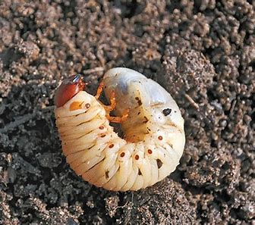
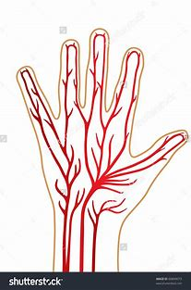
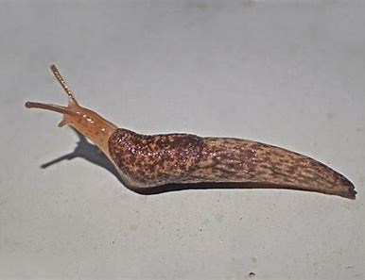
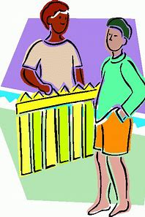
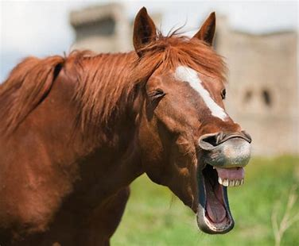
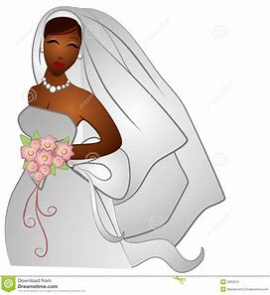
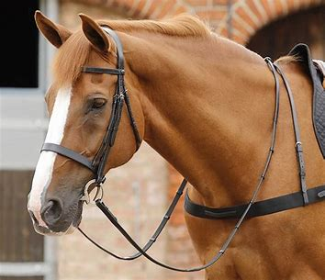
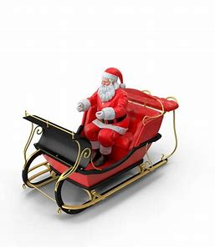
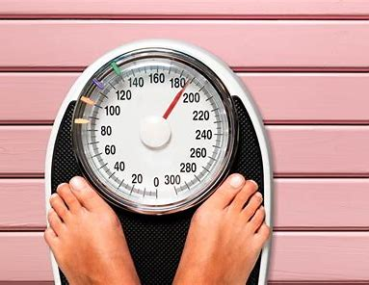
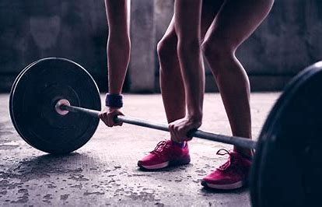
eight
reindeer
vein
grub
slug
eight
eighteen
eighty
weigh
reindeer
neighbour
child
children
eighteen
neighbour
neigh
eighty
reins
veil
weigh
weight
sleigh

Slide 30
Activity page2

Slide 31
Dictation

Slide 32
Name:
1. 2. 3.
4. 5. 6.
7.
8.
9.

Slide 33
veil

Slide 34
veil 2. sleigh

Slide 35
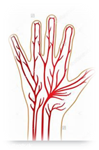
veil 2. sleigh 3. vein

Slide 36
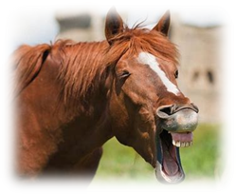
veil 2. sleigh 3. vein
4. neigh

Slide 37
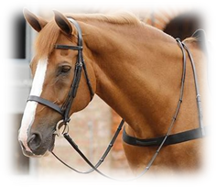
veil 2. sleigh 3. vein
4. neigh 5. reins

Slide 38
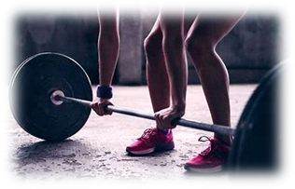
veil 2. sleigh 3. vein
4. neigh 5. reins 6. weight

Slide 39
veil 2. sleigh 3. vein
4. neigh 5. reins 6. weight
7. That dictionary weighs a lot.

Slide 40
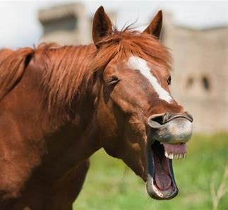
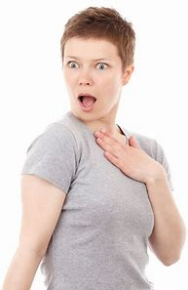
veil 2. sleigh 3. vein
4. neigh 5. reins 6. weight
7. That dictionary weighs a lot.
8. The horse neighed
at my friend.

Slide 41
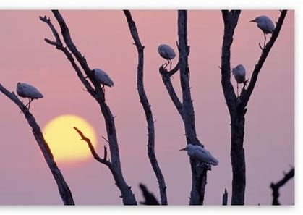
veil 2. sleigh 3. vein
4. neigh 5. reins 6. weight
7. That dictionary weighs a lot.
8. The horse neighed
at my friend.
9. There are eight birds
in the pear tree.

Slide 42
Homework

Slide 43
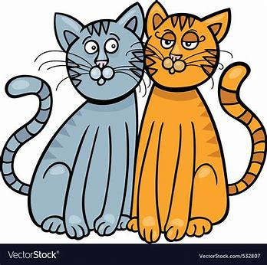
to, too or two?
I have cats called Micky and Minnie.
We went the mountains last summer.
There were many of us squeeze in the car.
I must go at o’clock. Do you want to come ?

Slide 44
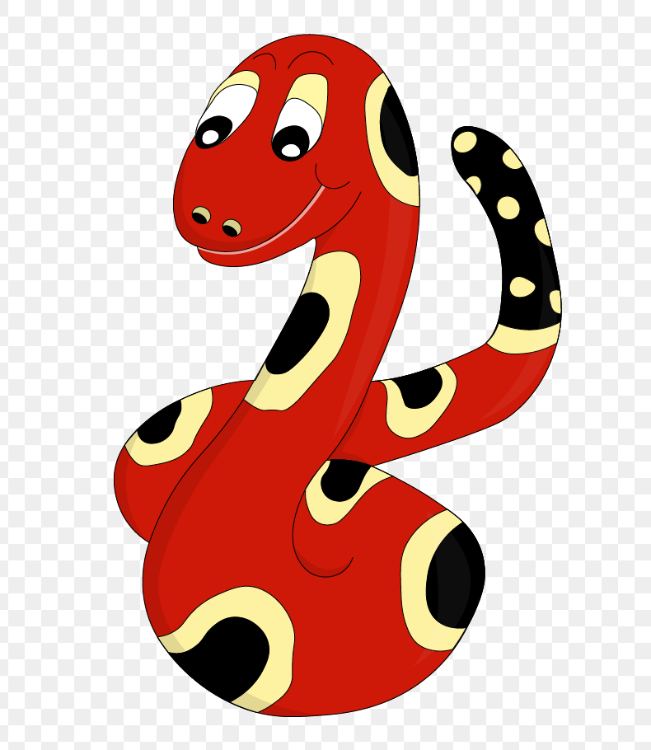
Thank you!
See you
next lesson.

